Slide 1
Sociology of Suicide
Sept 11, 2012
Notes:
Announcements:
1- I added some additional resources to the course module for this week that you may find useful for your group projects. These are websites with data on suicide and research and resources on prevention. I encourage you to explore these websites.

Slide 2
Please go SLOWLY through this slide show. Take time to reflect when I ask a question. Read the notes associated with the slides!

Slide 3
Wrap up from Thursday
Do Sociologists Ask?
T/F questions: Common Sense vs. Sociological Facts
Can study the sociology of just about anything
Notes:
Before we get into the Sociology of Suicide (main topic of this lecture), I want to clarify a few points that I’m afraid I didn’t explain well last week.
We ran through a series of T/F questions, where students commented on whether you thought these statements were true or false. I never really explained the point of this. The purpose was to illustrate the difference between thinking about society from a common sense perspective compared to thinking sociologically and knowing the social facts. So, the common sense view is more about the general ideas that a lot of people in society hold, what gets talked about in media, and some assumptions that most people have. Most of the statements I showed are things that people would generally assume to be true. But, in reality if you look at the data and gather evidence, they are false.
You all did a nice job of thinking critically about these statements and talking through them!
Also, I want to mention that because EVERYTHING in the world is social, sociologists study the sociology of just about anything. So, sociologists study all sorts of things, including: race, class, gender, inequality, marriage, sports, population change, community, cities, rurality, sexuality, poverty, socialization, family, crime, education, religion, natural resources, sustainability, identity, relationships, conflict, power, government and politics, culture, media, economics, health, community organizations, social movements, protests, and more. This is, in fact, one of the reasons why I decided to major in sociology as an undergrad. I didn’t want to have to choose and was having a hard time making up my mind. Sociology allowed me to study just about anything, but from a sociological perspective. In other words, the topic of study can be about anything, but the approach is what is the sociology.

Slide 4
Key Points
Individuals and the social world mutually influence one another
Sociologists rely on scientific evidence, not commonsense assumptions.
Conflict and change are inevitable
Sociological Imagination is a way of thinking about the world connecting individual troubles to public issues.
All is interconnected.
Notes:
These are some of the key points that I want to be sure you take home from class last week.

Slide 5
Key Concepts
Social processes—the actions taken by people in social units
Process of socialization—how we learn the social expectations for members of society
Social structure—people and groups that bring order to our lives and hold social units together
Social institutions—provide the rules, roles, and relationships to direct and control human behavior
Notes:
These are some of the key concepts that you should remember. Sociologists rely on these concepts to help us understand the social world.
Social structure includes all of the social interactions we have with people, groups, and organizations at all of those levels from the micro to the macro. We talk about it as the overarching set of social systems that structure our lives. Social structure tells us how to behave and constrains our activities into particular choices.
Social institutions include family, education, religion, politics, economics, science, sports, and health care. They are the parts of the social structure through which organized social activities take place.

Slide 6
Wrap up from Thursday
Do Sociologists Ask?
In your small groups, did you come up with any private troubles that are not public issues?
What might these be? Or, are all private troubles public issues?
Notes:
So, thinking back on the sociological imagination that we discussed at the end of class on Thursday…

Slide 7
Wrap up from Thursday
Do Sociologists Ask?
Although suicide is intensely troubling for individuals, their family and friends (a private trouble), the suicide rate, reasons for suicide, and relations to and expectations about suicide are very closely related to the way society is structured and to issues facing society.
Notes:
The statement on this slide demonstrates how suicide is sociological, even though it may seem at first thought to be a very private issue. We can use the sociological imagination to understand this public nature of the issue.
An important take home point about the sociological imagination:
We have this whole big complex world, and sociology (using our sociological imagination) can help us to understand the social roots of the suicide problem so that we can identify where and how there are possibilities to make positive change.
This is exactly what Copper Country Mental Health has asked of us for our group project.

Slide 8
Copper Country Suicide Project
Do Sociologists Ask?
Question
What can the Copper Country local community do better to reduce young adult suicide risk?
Research Approach
Learn about sociologically reasons for suicide (theory)
Make hypotheses
Examine local suicide data (collecting evidence)
Compare data across groups and geographies (analyze)
Correlate relevant local data (analyze)
Interpret data to answer question
Communicate results (Message to appropriate audience)
8 Groups of 4-5 people. Leaders will choose.
Notes:
The primary question that Copper Country Mental Health has asked us to address for our group project is here: What can the Copper Country local community do better to reduce young adult suicide risk?
Some definitions:
When we talk about the “Copper Country” for this project, we are referring to Houghton, Keweenaw, Baraga, and Ontonagon Counties.
By “young adults” we are talking generally about people age 10-24.
Ultimately, our question is about prevention. And so we’ll learn more about prevention on Thursday. But our question is also clearly about the sociological reasons for suicide– communities cannot do anything about the part of suicide that is due to psychological workings within an individual’s brain. But communities DO have a say at the meso level. They help to construct the social world that we live and operate within and that might affect suicide risk.
So the first step in our approach is to learn more about the sociological reasons for suicide so that we can develop appropriate hypotheses. We will learn more about our research approach and the methods, data, etc. next week. For now, we’ll focus on the theory that can help guide us to make hypotheses.
Hypotheses are essentially informed guesses about how and why society affects suicide. What might we expect from suicide rates in the Copper Country? Why? If we know more about the social influences of young adult suicide in the local area, we can start to make suggestions about what might need to change or do better to prevent it.
For the group project, the class will be divided into 8 groups of 4-5 people each. I will be choosing 8 group leaders. Think of these folks like team captains. The group leaders will have some say in who group members will be. We’ll have time in class next week for forming groups. If you would like to be a group leader, please contact me this week. I’ve already got some folks in mind and I’ll be contacting those of you I’m considering this week.

Slide 9
Sociology of Suicide
Do Sociologists Ask?
Primary Objective:
Understand the social basis of suicide
Reasoning behind it:
Demonstrate sociological thinking applied to a topic (how sociology works)
Theories that might explain suicide risk in the Copper Country for your group project
Notes:
Primary objective for today is to understand the social basis of suicide. The reasons for this are:
1- demonstrate sociological thinking applied to a particular topic (how sociology works)
2- get you thinking about reasons for suicide that might affect the Copper Country for your group project

Slide 10
Some Stats
Do Sociologists Ask?
Worldwide: 1 million suicide deaths a year
Over 36,000 people in the US die by suicide every year.
8 to 25 suicides are attempted for every suicide death.
4th leading cause of death for ages 18-65 in US
3rd leading cause of death ages 15-24
2nd leading cause of death among college students
According to National College Health Association survey, about 8% of college students in 2011 had at some point made a suicide attempt, and 20% had at some point seriously considered suicide. 7% had considered within last year.

Slide 11
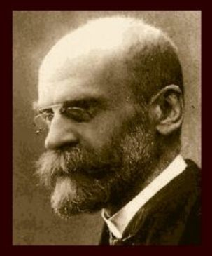
Durkheim– Father of Sociology
Do Sociologists Ask?
Emile Durkheim
(1858-1947)
Made case for sociology as a science
Le Suicide (1897)
One of his major works
Used study of suicide to demonstrate importance of sociology
Still most important sociology of suicide research
Notes:
Durkheim formally established sociology as a discipline of study.
One of his major works (Le Suicide) analyzed suicide from a sociological perspective.

Slide 12
Durkheim’s Study of Suicide
Do Sociologists Ask?
Private…but… SOCIAL
Approach: Statistics and scientific method. MACRO
Examined and explained variations in suicide rates amongst different groups and cultures
Finds stats to correlate with social phenomena (family, political and economic society, religion), rather than biological or cosmic phenomena.
The totality of suicides is topic of investigation, not individual suicides (Macro)
Goal– to explain variation among social environments in the incidence of suicide, not the suicides of particular individuals
Suicides (private trouble) occur within social context (public issue)
Notes:
Why does Durkheim study suicide?
He chose suicide, because his main point was to demonstrate the importance of sociology, even more than really learning anything about suicide in particular. So, he chose suicide because it was something that was widely presumed to be very private. People were thought to commit suicide because of biological mental illness, climate, and weather – things that are not social. Durkheim took up the challenge of disproving that these asocial things explain suicide rates. He used a process of elimination to disprove nonsocial explanations (mental alienation, race, heredity, climate, temperate, and imitation). Instead, Durkheim finds that suicide rates correlate with social phenomena, including: family, political and economic society, and religion. Thus, he makes the case for needing sociology.
In other words, Durkheim illustrates that this very private issue (suicide) is, in fact, social. It demonstrates the importance of sociology, because if something so private as suicide is really sociological, then everything is.
Today, sociologists might take many different approaches to studying suicide. We could study it at the micro level (looking at impact of small group interactions), the meso scale (examining community institutions) or the macro scale comparing rates across societies and cultures around the globe. Durkheim takes this macro scale approach. This means that he is not interested in explaining why individual people commit suicide, but rather on explaining the totality of suicides in a society (the suicide rate).

Slide 13
Durkheim’s Theory of Suicide
Do Sociologists Ask?
Egoistic (Weak Bonds)
Lack of integration of individual into society/family
Occurs in more individualistic societies
Altruistic (Strong Bonds)
Sacrifice for the good of the whole
Societies governed by custom or obedience (traditional cultures, military)
Notes:
Durkheim collected data on suicide rates for different groups and societies by country, gender, religion, etc. He compared rates to one another and he examined how they vary in relations to social variables (religion, family, political and economic organization, etc.).
As he examined all of these data and began to find correlations, he needed to be able to explain how/why social factors explain suicide. To do this, he developed a theory that would explain variation in suicide rates between social groups. He then tested this theory as his hypothesis by further reviewing the data to make sure the theory holds. The theory he came up with is that there are four different types of suicide, each of which is more of less common among different groups and societies. These are Durkheim’s social explanations for suicide. The four types include: egoistic, altruistic, fatalistic, and anomic. They are explained in this slide and the next one.
Its important to understand Durkheim’s theory, because it is still today the most important sociological explanation of suicide.
Egoistic suicide is common in societies that are highly individualistic and have weak social bonds. The US and Australia are these kinds of societies. The trouble here is that individuals are not well enough integrated into the social fabric of life. They are not well enough connected.
Altruistic suicide is the opposite. It is common in societies with very strong social bonds and little regard for individual needs. Here, people commit suicide for the good of the whole. For instance, if there is not enough food for all to eat, one member may commit suicide to ensure that others in the community have more to eat. Another example is suicide bombers who sacrifice their life for a communal cause they believe deeply in.
So…weak bond societies may have some problems, but strong bond societies may also. For instance, in a research study, Henry and Short (1954) fond that suicide rates are lower in cohesive groups, but homicide rates higher.

Slide 14
Durkheim’s Theory of Suicide
Do Sociologists Ask?
Fatalistic
Oppressive conditions
Slavery, sentenced to death
Anomic
Rapid change in social position produces discord within self and understanding of social role. Unable to cope with change
Modernity
Divorce, fast economic rise or fall
Notes:
Durkheim’s other 2 types are fatalistic and anomic.
Fatalistic suicide is common when people feel they are so doomed by social conditions, they may as well die. It is common among heavily oppressed groups.
Anomic suicide is associated with social changes associated with modernity/industrial life. Durkheim lived at a time where life was rapidly transitioning away from rural agricultural society toward industrial urbanization. He was critical of these patterns. He believed that anomic suicide occurs when social life changes so quickly that people cannot cope. It would be expected in societies undergoing a lot of change, or in societies where everyday patterns are disrupted by things like divorce, job loss, etc.

Slide 15
Durkheim’s Theory of Suicide
Do Sociologists Ask?
Different societies/groups have different levels of social bonds and modernity. This explains variations in suicide rates.
Social integration
Modernity
High suicide rates signify a flaw in the social fabric
Notes:
This slide summarizes Durkheim’s theory.
The key factors here are (1) social integration (weak bonds/strong bonds, connectivity) and (2) modernity (modern industrial/globalized living). Social integration is key because human interaction is so important to individuals. We NEED our social connections. Modernization can erode the ties of the individual to society. These factors are still very important explanations of suicide today. See the Stack reading Part 2, assigned for this week.
Social factors can affect individuals’ and societies’ degree of social integration and thus tend to be correlated with suicide rates: moving, age, religion, divorce, social change, homosexuality, and political organizing.
In the end, we might think of the observation of high suicide rates as signifying a flaw in the social fabric. In this sense, suicide tells us something about our society. It could be thought of as a kind of warning sign that there are things we need to work on.

Slide 16
Modern Explanations
Do Sociologists Ask?
Still much we don’t understand
Biology/psychology is important, but so is sociology
Durkheim’s theories regarding types and emphasis on social integration and modernity stand today
Cultural Explanations
Gender roles, violence/gun access (opportunity)
Socioeconomic Explanations
Direct or indirect effects (marital trouble, alcohol, moving)
Economic stress and unemployment are important correlates. Relative deprivation may also play role.
Notes:
Durkheim’s work was a hundred years ago. What about more recent sociological explanations?
There is still a lot we don’t understand. There are several studies, but not much coming to any kind of definitive conclusions.
Some generally accepted facts:
Biology/psychology is important, but so is sociology. Durkheim went a bit overboard stressing the social.
Social integration is still seen as major contributing factor to both individual suicides and explaining macro suicide rates
Cultural explanations shown to be important include:
Gender Roles. The ways in which males and females are socialized matters. Males use more deadly methods because socialized to be strong, toward violence, never show weakness.
Culture of violence. Media attention to violence desensitizes us to guns and violent acts. Dramatic events on TV can glorify.
Opportunity Theory. Access to firearms makes suicide an available option.
Socioeconomic explanations shown to be important include:
Economic stress and unemployment
Relative deprivation (income inequality) may also play a role
Socioeconomic trouble may directly affect suicide, but it may also affect other variables that in turn, affect suicide. For instance, economic trouble is associated with marital trouble. Divorce is associated with suicide. So, economic trouble may lead to marital trouble (or alcohol abuse or moving to find a new job, etc.) which then leads to less social connection and suicide.

Slide 17
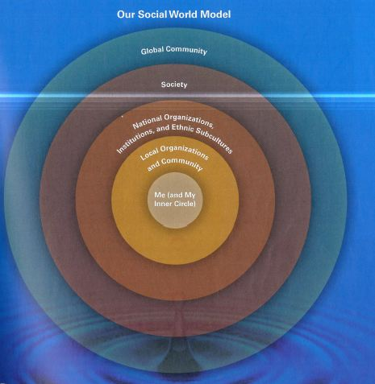
Notes:
Going back to the Our Social World model, there are ways that social life affects suicide at each level, from the micro to the macro.
Reflect back on your Discussion question for today. How is suicide a public issue at each of these levels within the Social World model? Think about each level.
If social integration is key, our inner circle matters, as well as some of the macro issues we’ve been focusing on so far today.
The micro level is especially important for prevention, which is what we’ll discuss on Thursday.
How might the social theories of suicide in this slideshow apply in the Copper Country? Think about multiple levels from micro to macro. Brainstorm your ideas. Write them down! These will inform your group project.

Slide 18
What State in US has highest suicide rate?
Notes:
Now I want to move away from the theory and turn to the data. But…keep the theory in mind as you interpret these data.
What state do you think has the highest rate? Why would that be the case?

Slide 19
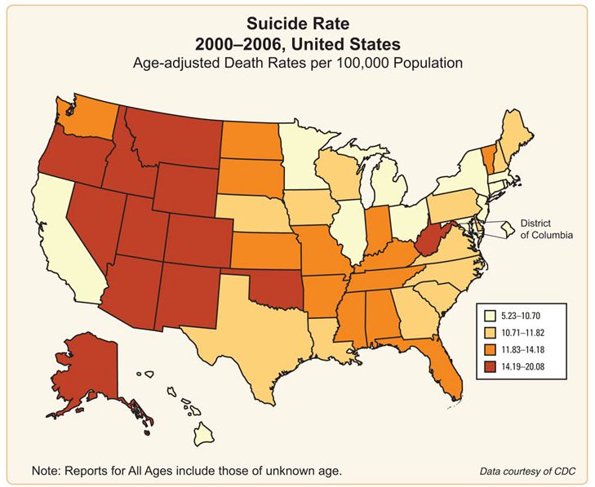
What State in US has highest rate?
Montana- 22.5
Alaska- 20.5
Wyoming- 20.4
Idaho- 19.7
Nevada- 19.1
Wisconsin- 12.8 Michigan- 11.7
New York- 7.3
New Jersey- 6.4
Washington DC- 4.8
Notes:
Data in the map are from National Institute of Mental Health website, which uses data from US Center for Disease Control, which keeps tracks of mortality statistics.
Data on right are from 2009. Montana is highest. Montana through Nevada are the top 5 highest rates. Washington DC is lowest. New Jersey and New York are second and third lowest. Michigan does pretty well (around 15 lowest). Wisconsin is only a little higher.
Did you guess correct? Did you have the right idea?
Thinking sociologically, how might we explain these patterns in the data? Think back on the theories we’ve been reviewing. Do any of these theories seem consistent with these rates?

Slide 20
Which country do you think has the highest suicide rate?
Notes:
Which country in the world do you think has the highest rate? Why would that be the case?
Which country do you think has the lowest rate? Why?

Slide 21
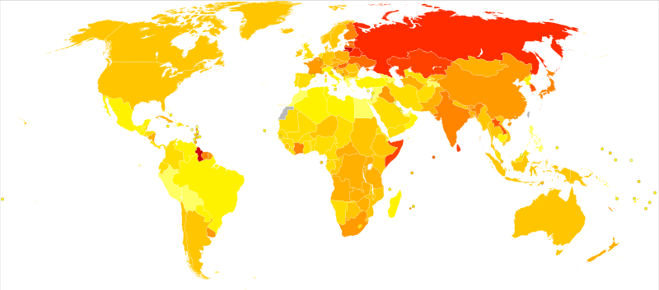
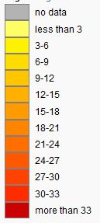
Source: World Health Organization, 2011
Notes:
Did you guess correctly this time? Did you have the right general idea?
What is surprising? Why?
The next slide includes the numerical data on some high and low suicide rate countries.

Slide 22
Suicides per 100,000 people per year
Rank | Country | Male | Female | Total | Year
1 | Lithuania | 61.3 | 10.4 | 34.1 | 2009
2 | South Korea | 41.4 | 21.0 | 31.2 | 2010
3 | Guyana | 39.0 | 13.4 | 26.4 | 2006
4 | Kazakhstan | 43.0 | 9.4 | 25.6 | 2008
5 | Belarus |  |  | 25.3 | 2010
6 | Hungary | 40.0 | 10.6 | 24.6 | 2009
7 | Japan | 33.5 | 14.6 | 23.8 | 2011
8 | Latvia | 40.0 | 8.2 | 22.9 | 2009
9 | China |  |  | 22.23 | 2010
10 | Slovenia | 34.6 | 9.4 | 21.9 | 2009
19 | Finland | 27.2 | 8.6 | 17.6 | 2010
38 | Canada | 17.3 | 5.4 | 11.3 | 2004
41 | United States | 19.0 | 4.9 | 11.8 | 2008
95 | Peru | 1.1 | 0.6 | 0.9 | 2000
Notes:
Countries in this table are ranked from highest suicide rate to lowest. Of course, there are lots of countries not included in this slide. I tried to pick some key ones. Rates are broken down by male and female.
How might we explain these patterns?

Slide 23
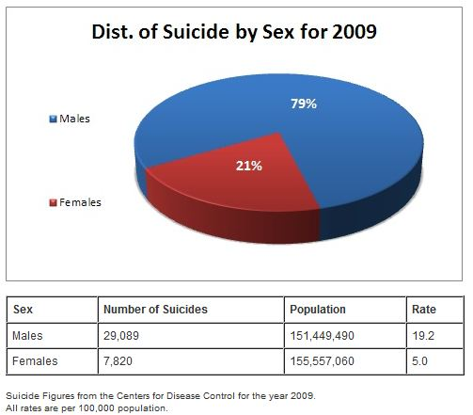
Notes:
Going back to the US only now. Let’s look at suicide rates for different social groups.
This slide shows rates broken down by sex.
How might we explain these patterns? What is it about society that makes male rates so much higher than females?
We’ve learned from readings that although male deaths from suicide are much higher than females, females are more likely to attempt suicide. Why might this be the case? Think sociologically, and keep thinking about those multiple levels of influence.

Slide 24
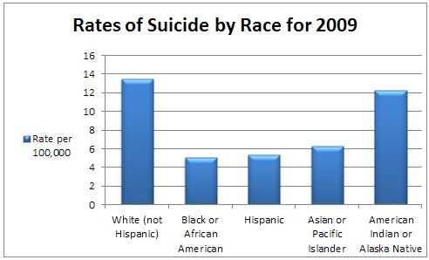
Notes:
How might we explain these patterns?

Slide 25
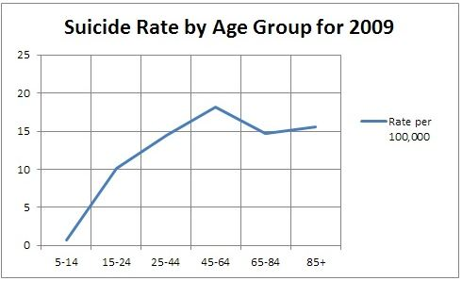
Notes:
The Portner reading really emphasized teen suicide. But this chart puts it in better perspective with all age groups. Even though teen rates have increased tremendously since the 1950s, they are still significantly lower than rates for older adults.
One trouble with this chart that we have to note is that it does not consider male/female differences (which we’ve seen to be a big difference) and it lumps age 15-24 all togther, when rates are quite different for 15-19 than 20-24. Rates are higher at age 20-24.
How might we explain these patterns?

Slide 26
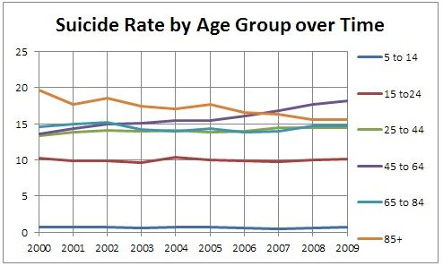
Notes:
It can help to look at changes in suicide rates by age over time. This chart shows how rates have changed since 2000.
To give you a deeper context, between the mid-1950s and the late 1970s, the suicide rate among U.S. males aged 15-24 more than tripled (from 6.3 per 100,000 in 1955 to 21.3 in 1977). Among females aged 15-24, the rate more than doubled during this period (from 2.0 to 5.2). The youth suicide rate generally leveled off during the 1980s and early 1990s, and decreased in the late 1990s. Since 2000, the rates among young adults have been stable, but there was a noticable bump up between 2003 and 2004.
Note the decline in suicide rates among age 85 plus. Also note increase among age 45-64. Think about what was going on in the social world 2000-2009. What might explain these changes?

Slide 27
Theorize about Youth Suicide in the Copper Country: 1- Do you think it is high or low? Why? 2- What might be the sociological factors influencing local suicide rates?
Notes:
Write your ideas about this down. This will help to inform hypotheses you’ll need to make in your group project.

Slide 28
For Thursday…
Suicide Prevention session
Portner, Part 3
Stack will help for your group project. Also see suggested readings
QUESTIONS?
NOW…TAKE YOUR QUIZ
Notes:
Read Portner, Part 3. Also, explore the websites I added to Canvas regarding suicide prevention and awareness.
Although I said you didn’t need to focus on the Stack readings for this week, keep them in mind. There is a lot of research in those readings that can help you inform your group projects.
Please email me if you have any questions. Or we’ll also have time in class on Thursday for you to raise questions.
After completing this powerpoint, take your quiz on Canvas.

