Slide 1
Socialization
Oct 2, 2012
Notes:
1- Quiz
2- Remind that short 1-2 pager can and should get incorporated into paper for your group projects
3-Cumbria
4- Antro club outing
http://www.youtube.com/watch?v=IHjaW9sXl7s

Slide 2
Quiz
Do Sociologists Ask?
How are we socialized?
In families
In schools
By our genes
Throughout our lives
By our peers
Depends on our social class
By the media
Depends on our gender

Slide 3
Quiz
Do Sociologists Ask?
How are we socialized?
In families
In schools
By our genes
Throughout our lives
By our peers
Depends on our social class
By the media
Depends on our gender

Slide 4
Quiz
Do Sociologists Ask?
Which theoretical perspective(s) critique(s) hierarchical power structures?
Symbolic interaction
Rational choice theory
Structural-functionalism
Conflict theory
Feminist theory

Slide 5
Quiz
Do Sociologists Ask?
Which theoretical perspective(s) critique(s) hierarchical power structures?
Symbolic interaction
Rational choice theory
Structural-functionalism
Conflict theory
Feminist theory

Slide 6
Quiz
Do Sociologists Ask?
Choose one of these theoretical perspectives: symbolic interaction, structural-functional, or conflict. How does this perspective help us to understand culture?
What are norms? Explain what they are and give a specific example of how a norm works.

Slide 7
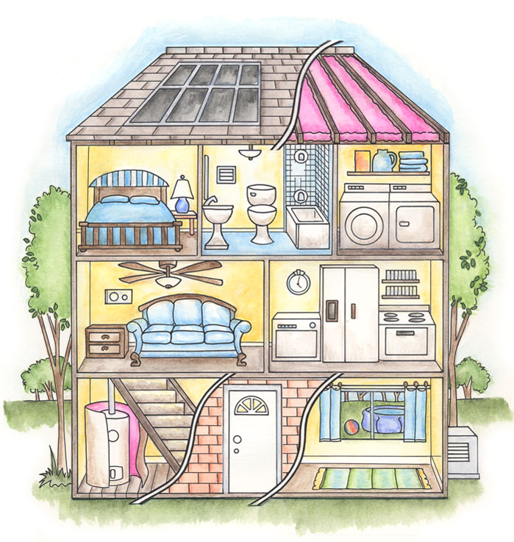
Social Structure
(Walls, roof, the shell):
Groups
Organizations
Institutions
Social Processes
(electricity, water, people carry out activities):
Culture
Socialization

Slide 8
Norms are important
Do Sociologists Ask?
Trump values and beliefs in terms of influencing behavior
Why we act the way we do
Not always consistent with values and beliefs

Slide 9
The Social Self
Do Sociologists Ask?
How do we get to be who we are?
Nature or Nurture?
Agents of socialization
Interactions with others
Looking Glass Self
We see ourselves as others see us
Significant Others, Groups, Generalized Other
Notes:
Why family tradition?

Slide 10
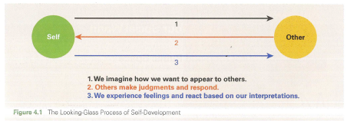
Notes:
Read story if time. What does this teach us?

Slide 11
Tell a Story about your Socialization
Do Sociologists Ask?
Agents of socialization help shape us into who we are today. Tell a story about your own life.
How has a specific agent of socialization (choose 1) made you into who you are?

Slide 12
Socialization & Suicide
Do Sociologists Ask?
How might socialization affect suicide?

Slide 13
Coming Up:
Thursday
Turn in a 1-2-page write up summarizing extent of problem for review
Chapt 5 in text

