Slide 1
Social Stratification
Oct 16, 2012
Notes:
Opening: Tupac- http://www.youtube.com/watch?v=1eHTe_RIg4c&feature=related
Poverty– http://www.youtube.com/watch?v=xc2L2DkIK-w
Trump– http://gawker.com/5832284/take-a-tour-of-donald-trumps-horribly-gaudy-new-jet
Gapminder-- http://www.gapminder.org
Greatest Speech-- http://www.youtube.com/watch?v=WibmcsEGLKo

Slide 2
Stratification
Do Sociologists Ask?
Layering of society into ranked categories
Categories affect how resources are distributed.
Some people are more likely to succeed/fail than others.
What are some ways that we are divided or ranked?
Notes:
Income, race, gender, age, educational attainment, property, caste, occupation, disability, physical appearance, etc.
Show video of poverty then video of Trumps plane.

Slide 3
Unequal, but fair?
Do Sociologists Ask?
Stratification affects life chances
Loaded dice
Some more likely to roll a 6, others a 1
Not about being good or bad or even innate abilities, but more about how society is structured
Socialization & culture (micro)
Organizations and institutions (meso)
Global economics and politics (macro)
Social mobility
Notes:
Fairness is more of a philosophical/value issue. But, sociologists CAN help to understand why we have inequality and how it works, which is important information that can help people think about and determine for themselves if it is fair or not and what should or should not be done about it.

Slide 4
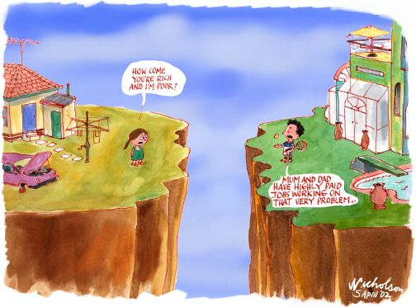
Why do we have such inequality?
Do Sociologists Ask?
Notes:
Symbolic Interaction
Structural/Functionalism
Conflict theory

Slide 5
Class | Words | Words/Hour
Professional | 1,100 | 297
Working | 700 | 217
Low Income | 500 | 149
Notes:
Table shows number of words that children at 3 years old know and use by social class.
Language is an important part of culture and a way that inequality is reproduced through socialization, or symbolic interaction. Language is a set of symbols and a function of how we interact with one another. How might this difference in vocabulary difference affect one’s success in school? How might an expanded vocabulary affect one’s opportunities in life?
Tell my story about grad school having my grammar corrected. I’m not sure I did very good on that test.

Slide 6
Notes:
Structural/Functionalism says that inequality is always part of society and probably necessary and good overall.
Doctor example:
Some positions in society are more highly valued because they are very important and require a lot of expertise.
Preparation involves talent, time, and money. We need motivation to get people to want to do these jobs– income, prestige, power
We need this unequal distribution of income/prestige/power to motivate folks to take on increased responsibilities, training, stress, etc.
Where does this fall apart? – rock stars vs. teachers, pro athletes vs. fire fighters, inherited wealth

Slide 7
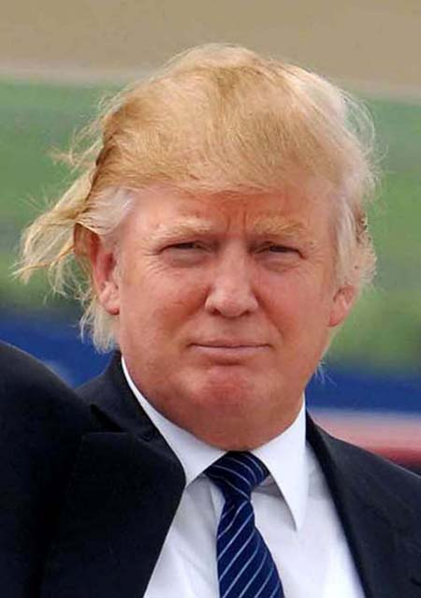
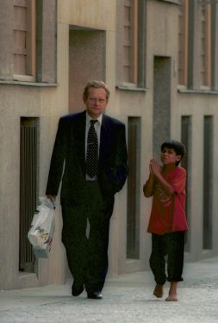
Notes:
Conflict says that inequality is result of struggle over resources, where powerful take more than just what they need, but whatever they can. Powerful groups control institutions, organizations, norms, and values. World is divided into “haves” and “have nots”. Haves control the means of production and get to make the rules.

Slide 8
THINK ABOUT IT: - Where do you fall in the social stratification system? - How does each of the 3 perspectives explain where you fall?
Notes:
Partner up

Slide 9
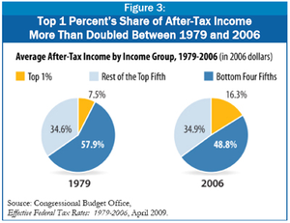

Slide 10
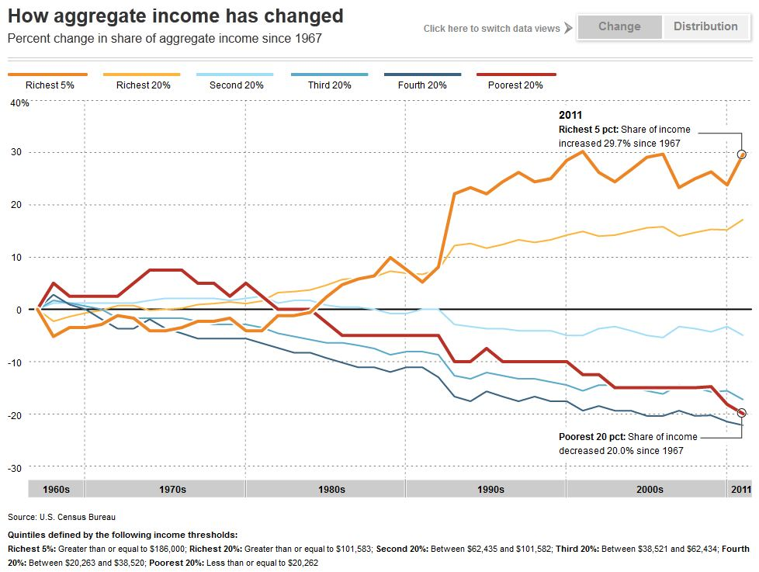
Notes:
Rich getting richer charts

Slide 11
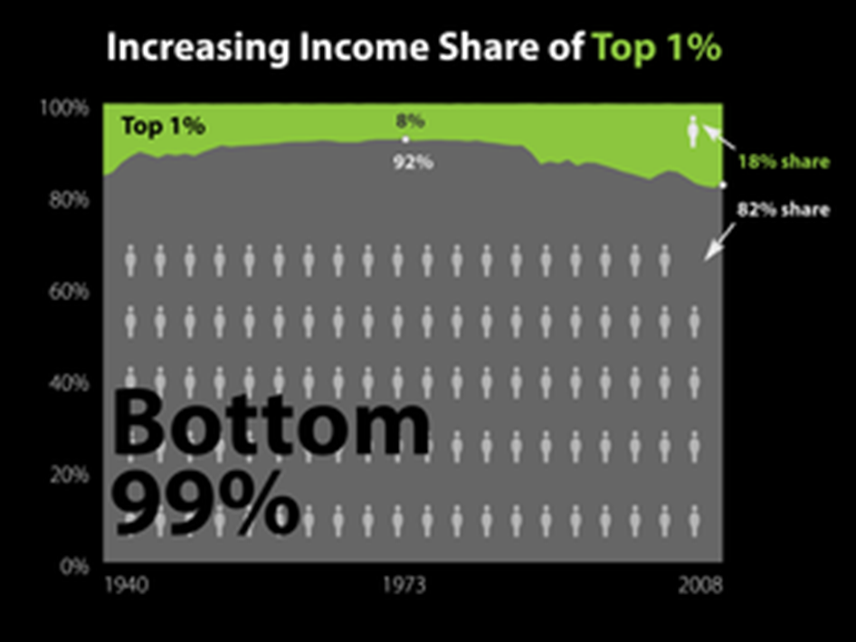
Notes:
Gap between the rich and poor grew since 2006 to reach all time high in 2011.

Slide 12
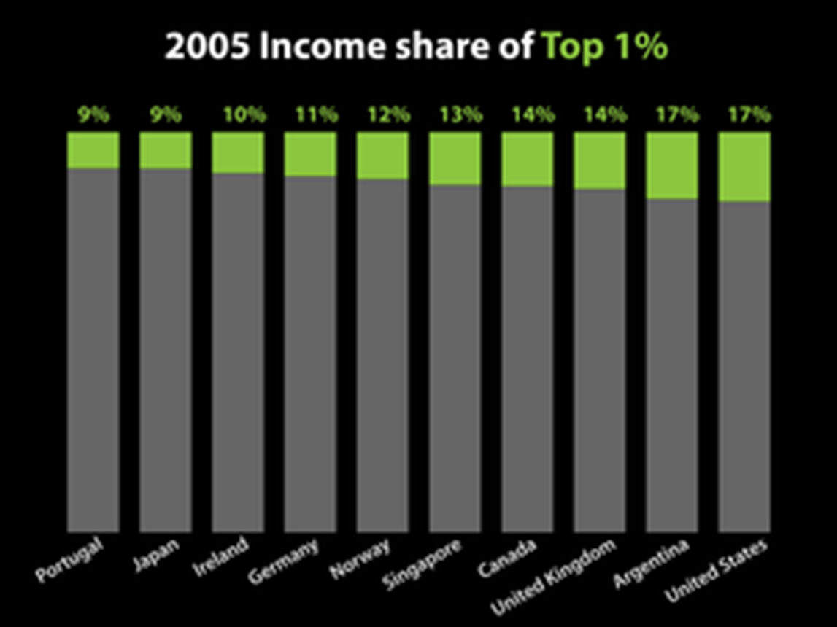
Notes:
Gap between the rich and poor grew since 2006 to reach all time high in 2011.

Slide 13
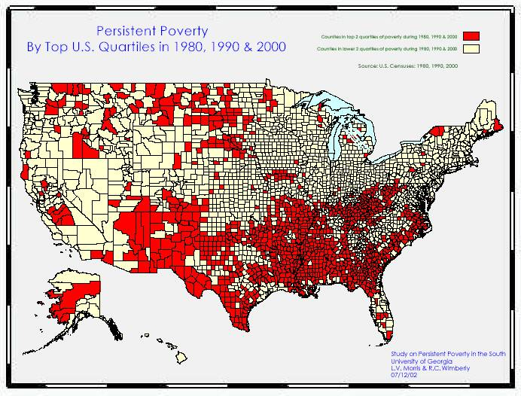

Slide 14
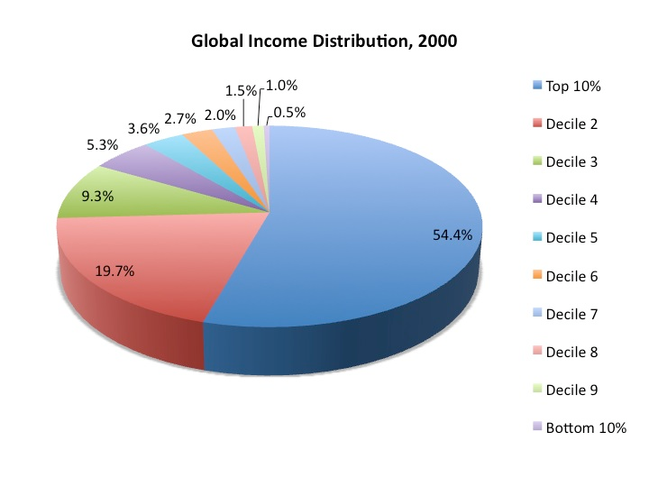
Notes:
References:
Dikhanov, Yuri. 2005. Trends in Global Income Distribution, 1970-2000, and Scenarios for 2015. Human Development Report Office (HDRO), United Nations Development Programme (UNDP).

Slide 15
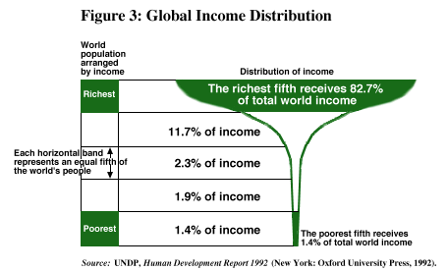
Notes:
Go to gapminder.
About 9 million children under 5 die each year, and mostly from preventable causes – lack of adquate food, clearn water , routine immunization

Slide 16
THINK ABOUT IT: - What does the status of “yooper” really mean?
Notes:
Partner up

Slide 17
Life Chances & Social Mobility - What are your chances for social mobility? Will you move up or down or stable? - What are the macro-meso-micro factors affecting your life chances?
Notes:
Partner up

