Slide 1
Notes:
Extra credit

Slide 2
Poverty
Oct 18, 2012
Notes:
Greatest Speech-- http://www.youtube.com/watch?v=WibmcsEGLKo
Cultural capital (how to marry the rich)-- https://www.youtube.com/watch?v=yvibi2Cph-E

Slide 3
Poverty
Do Sociologists Ask?
Absolute
Not having resources to meet basic needs
May result in starvation and/or death from preventable causes
Relative
Income falls below poverty line of given country
Inadequate standard of living relative to others in country
May result in food insecurity, shortened life expectancy, higher infant mortality

Slide 4
Poverty is concentrated in certain geographic areas
Do Sociologists Ask?
www.socialexplorer.com
Tool for visualizing social data, including poverty, unemployment, etc.
Poverty definition according to US Census:
Following the Office of Management and Budget's (OMB) Statistical Policy Directive 14, the Census Bureau uses a set of money income thresholds that vary by family size and composition to determine who is in poverty. If a family's total income is less than the family's threshold, then that family and every individual in it is considered in poverty. The official poverty thresholds do not vary geographically, but they are updated for inflation using Consumer Price Index (CPI-U). The official poverty definition uses money income before taxes and does not include capital gains or noncash benefits (such as public housing, Medicaid, and food stamps).

Slide 5
Why do we have poverty & inequality?
Do Sociologists Ask?
Structural
Macro
Meso
Micro
Cultural
Values, beliefs, norms, symbols, language
Reproduced over Time
Concentrated in Space
Notes:
We talked on Tuesday about the broad theoretical perspectives and how they explain inequality. These broad theoretical perspectives are said to be able to explain any social phenomenon, but they don’t get very specific about any particular component of social life.
We also have social theories that are more grounded in direct research and evidence to explain particular phenomena, like poverty and inequality.
These theories tend to take one of two approaches– structural or cultural and there are some academic arguments over which is more important. But, its generally understood that both play a role and that they may impact one another. So, when we talk about structural, we’re talking about the macro, meso, and micro level systems, institutions, organizations, and social relationships that affect a person’s life chances. When we talk about cultural, we’re really talking about values, beliefs, norms, symbols, language, and ways of being that affect how people understand the world and interact within it.
From both of these approaches, it is important to recognize that poverty is concentrated in place and reproduced over time. The structures and cultures that affect poverty tend to be passed down through generations so that people who begin life in a relatively deprived situation face more obstacles throughout life in comparison to those who are born with more advantages.

Slide 6
Review Articles
Do Sociologists Ask?
Partner with same article
Main point of the article
How does the article address structural and/or cultural approaches to understanding poverty?
Macro, Meso, and Micro
What solutions are suggested?
In what ways do you agree with the article?
In what ways do you think the article falls short?

Slide 7
Review Articles
Do Sociologists Ask?
Partner with different article
Explain what the article is all about
How does the article address structural and/or cultural approaches to understanding poverty?
Macro, Meso, and Micro
Would you recommend the article? Why or why not?

Slide 8
Structural Explanations
Do Sociologists Ask?
Capitalism
Meso
Micro
Divorce
Social Capital
Schools, Religion, Prison, Eviction, Childcare Access, Job Discrimination, Segregation,
Food aid stations
Macro
Recessions
Economic Restructuring
Global relations/food systems/War

Slide 9
Cultural Explanations
Do Sociologists Ask?
Discrimination
Distrust
Subculture of defeatism
Cool pose culture
Is cool pose culture just a ghetto thing?
Structural and Cultural reinforce one another
Repeated failures
Cultural Capital

Slide 10
Cultural Capital
Do Sociologists Ask?
Knowing how to behave within a culture
Little things that we don’t even thing about but send clues
How to marry the rich

Slide 11
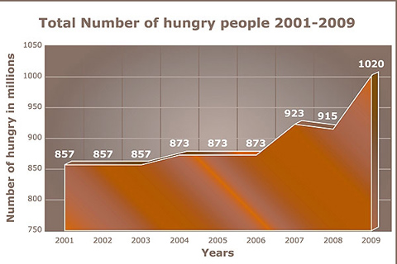
Notes:
Hungry people data from UN report.

Slide 12
Intersection
Do Sociologists Ask?
Inequalities multiply
Notes:
Race-class-gender-sexuality-age-place- etc.

Slide 13
A little hope
Do Sociologists Ask?
Greatest video ever made

