Slide 1
Group Project Outline
Do Sociologists Ask?
Describe the 1 hypothesis your group will investigate. What do you expect to find and why? Include why this is an important hypothesis to study
Clearly and specifically describe what evidence you’ll use to investigate that hypothesis
Published research articles
Social theories/conceptual arguments from text, readings, articles
Secondary data (statistics, etc.)
Explain what your product will be. What will you create? Why is this an appropriate product?
Outline Due by Noon on Halloween. Email.

Slide 2
“We” vs. “They” A Discussion of Race Continued
Oct 25, 2012
Notes:
Slideshow:
http://www.pbs.org/race/005_MeMyRaceAndI/005_01-slideshow.htm
Tale of two families:
http://www.pbs.org/race/006_WhereRaceLives/006_02-taleoftwo.htm
Story we tell:
http://www.youtube.com/watch?feature=player_embedded&v=4UZS8Wb4S5k
White Privelege:
http://www.youtube.com/watch?v=pAljja0vi2M&feature=related
Michigan Affirmative Action
http://www.npr.org/news/specials/michigan/

Slide 3
Summary
Do Sociologists Ask?
Race is NOT a real biological difference
Race IS important as an idea and has important consequences
Stereotypes affect how we interact and our life chances
White stereotypes

Slide 4
Racism is real
Do Sociologists Ask?
Are you racist?
Of course. We all are. We were socialized in a racist society and we carry that with us.
We CAN fight back against it, but it still there under the covers
Racism is the institutional arrangement that favors one racial group over another

Slide 5
So, how did it become real?
Do Sociologists Ask?
http://www.youtube.com/watch?feature=player_embedded&v=4UZS8Wb4S5k
Needed justification for inequality
Science played a big role
People in power benefitted

Slide 6
How do we know we still have racism?
Do Sociologists Ask?
http://www.pbs.org/race/005_MeMyRaceAndI/005_01-slideshow.htm
http://www.pbs.org/race/006_WhereRaceLives/006_02-taleoftwo.htm
Huge outcome inequalities by race/ethnicity around the world and in the US

Slide 7
White Privilege in a “postracial” society
Do Sociologists Ask?
http://www.youtube.com/watch?v=pAljja0vi2M&feature=related

Slide 8
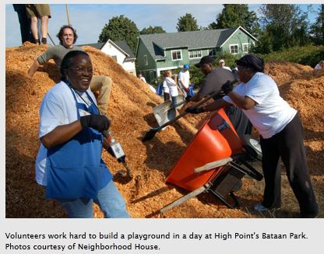
So, what can we do about it?
Do Sociologists Ask?
Notes:
Affirmative Action activity

Slide 9
Institutional Change
Do Sociologists Ask?
Non-discrimination policies– Equal Opportunity Laws (http://www.eeoc.gov/facts/qanda.html)
Affirmative Action
Positive steps to avoid unintentional discrimination
Each Government contractor with 50 or more employees and $50,000 or more in government contracts is required to develop a written affirmative action program (AAP) for each of its establishments.
A written affirmative action program helps the contractor identify and analyze potential problems in the participation and utilization of women and minorities in the contractor's workforce.
If there are problems, the contractor will specify in its AAP the specific procedures it will follow and the good faith efforts it will make to provide equal employment opportunity.
Expanded efforts in outreach, recruitment, training and other areas are some of the affirmative steps contractors can take to help members of the protected groups compete for jobs on equal footing with other applicants and employees.

Slide 10
Preference Policies
Do Sociologists Ask?
Give minority groups preference in hiring, admissions, scholarships, etc.
Should preference policies be given to accomplish diversity?
University of Michigan Debate
How does this extend to other circumstances beyond admissions to U of MI?
Notes:
Ultimate whether or not preference policies are a good idea is not a sociological question. This is a question for values and politics. But, sociological information and sociological thinking can gather evidence that can inform the debate.

Slide 11
Michigan Affirmative Action Suit
Do Sociologists Ask?
http://www.npr.org/news/specials/michigan/
Divide into two sides for debate
Lay out the evidence
Present arguments
How does this extend to other circumstances beyond admissions to U of MI?
Notes:
In 2007, Michigan voters approved a ban on the use of race and gender preferences in university admissions and government hiring.

