Slide 1
Gender & Sexuality
Oct 30, 2012
Notes:
http://www.youtube.com/watch?v=5AhU12zC8fc
I enjoy being a girl, sort of:
http://www.thisamericanlife.org/radio-archives/episode/99/i-enjoy-being-a-girl-sort-of
NOTE: I got through first 12 slides and exercise. I’m not sure I would do the fatty suit recording again. The Tom Boys one might be better.
http://www.thisamericanlife.org/radio-archives/episode/374/somewhere-out-there?act=2#play

Slide 2
Sex, Gender, & Sexuality
Do Sociologists Ask?
Words that say something about male or female on the board
Notes:
Have students write words on board as they listen/watch video about reversed gender roles.
Then, as a group, place the words into their categories (sex, gender, or sexuality and male/female connotations)

Slide 3
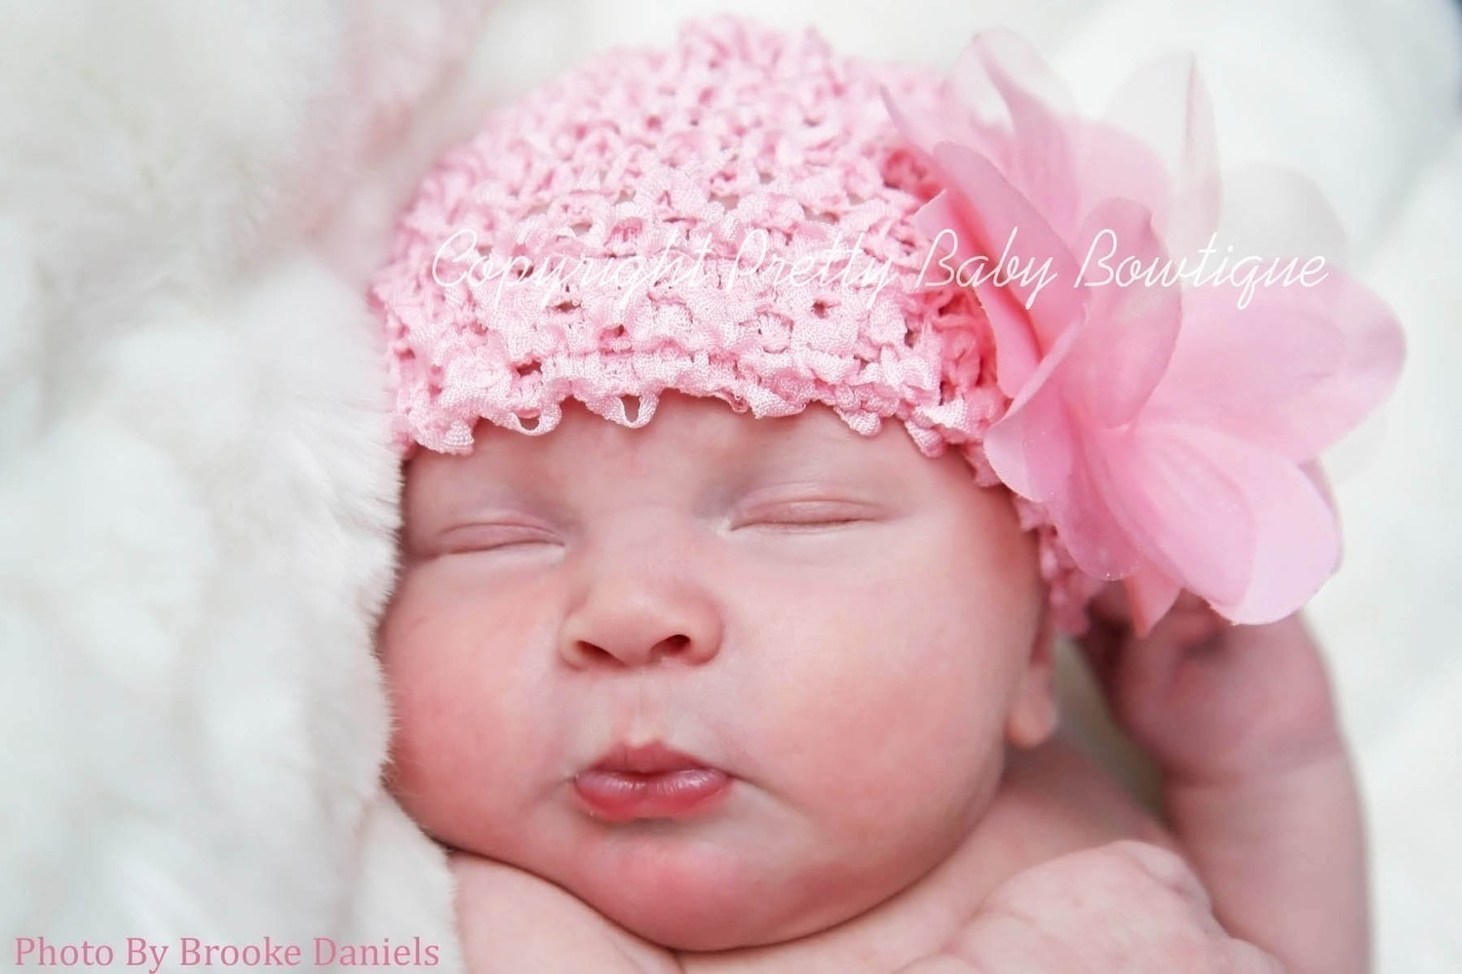
It’s a Girl!
Notes:
We are grouped by sex at micro-meso-macro levels from the moment we are born. Society tells us that sex (and so gender) is important.

Slide 4
The Rickie & Kathe Story
Notes:
Get a picture

Slide 5
How did you become gendered?
Do Sociologists Ask?
Which of your personality traits, behaviors, and beliefs do you consider “masculine”?
How did you learn that those are considered masuline characteristics?
Which of your personality traits, behaviors, and beliefs do you consider “feminine”?
How did you learn that those are considered feminine characteristics?
Of those traits/beliefs/behaviors, which were you born with?
Of those traits/beliefs/behaviors, which did you learn? How did you learn them?

Slide 6
Doing Gender
Do Sociologists Ask?
We are constantly active in creating and re-creating what gender means
What are some ways that we do gender?

Slide 7
Our Gender Roles Matter
Do Sociologists Ask?
Because they affect how we live our lives
Males AND Females live consequences
Fatty Suit
Micro level– self concept, households and families
Meso level- organizations, power, access to resources
Macro level- leadership, culture, beliefs, opportunities, access to resources
Notes:
Ideas about masculinity may increase males likelihood of committing suicide
Fatty Suit? Or Tom Boys?
Story about Samer’s comment to me about only working with me because “young attractive female”

Slide 8
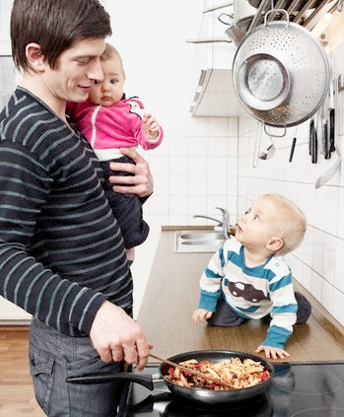
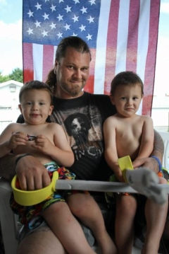
Stay at Home Dads- A Growing Trend
Do Sociologists Ask?
Notes:
What are some of the issues?

Slide 9
Gender Stratification
Do Sociologists Ask?
Isn’t gender inequality over?
“Women around the world do two thirds of the work, receive 10% of the world’s income, and own 1% of the world’s means of production”
Violence against women remains rampant
Women have few rights in many countries

Slide 10
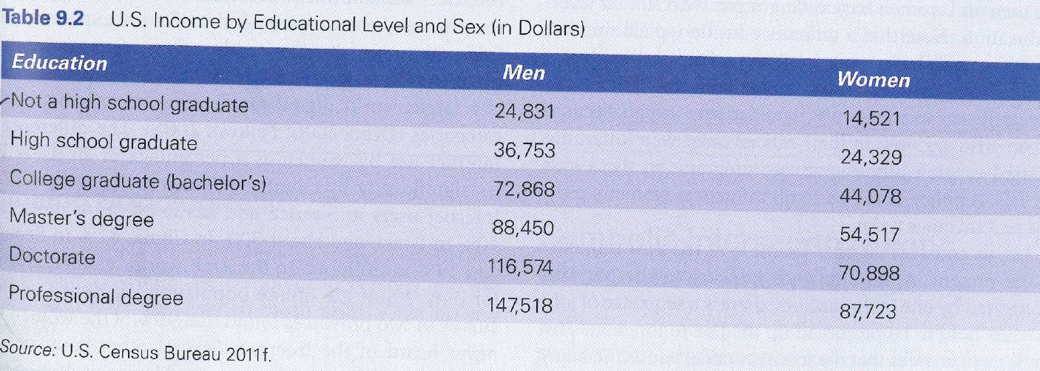
Gender Stratification
Do Sociologists Ask?
Well, in the US anyway?

Slide 11
As of 2011, the number of women in US senate is at an all-time high, with 17 of 100 senators.
In terms of % of women in national governments, US ranks 90th in the world, with 16.7%)
Behind:
1- Rwanda (56%)
3- Sweden (45%)
4- South Africa (44.5%)
12- Costa Rica (38.6%)
20- Nepal (33.2%)
60- China (21.3%)

Slide 12
But we don’t feel so prejudiced…
Do Sociologists Ask?
So why would this be the case?
Subtle institutionalized sexism
Inequality between the sexes is separate from any form of personal prejudice or animosity toward women
Exercise

