Slide 1
Quiz: Thursday, Nov. 7
Do Sociologists Ask?
Institutions, p. 277-283 in text
Chapt. 10– Family
Chapt. 11- Education & Religion
Dodson & Luttrell- Families Facing Untenable Choices (posted on Canvas, week 9)
Ecklund- Religion and Spirituality among Scientists (posted on Canvas, week 10)

Slide 2
Institutions: Family
Nov 1, 2012
Notes:
I enjoy being a girl, sort of:
http://www.thisamericanlife.org/radio-archives/episode/99/i-enjoy-being-a-girl-sort-of
Same sex marriage in MN:
http://video.pbs.org/video/2290302882

Slide 3
Institutions
Do Sociologists Ask?
Complex set of groups or organizations
And the statuses within them
Family, Education, Religion, Politics, Economy, Medicine, Science, Military
Organized, patterned, and enduring
provide guidelines for behavior
norms of conduct
help each society meet its basic survival needs
Socialize children, educate young, provide a sense of meaning to life, provide goods (food, clothing, etc.)

Slide 4
Institutions are Vital
Do Sociologists Ask?
Society would not be able to meet basic needs and would collapse without them
Integrate micro-meso-macro levels of society
Provide coherence and stability in our lives
Various institutions are interconnected, rely upon one another, and are affected by one another.
Connections between politics and economy
Have a conservative bias & interest in stability
Notes:
http://www.thisamericanlife.org/radio-archives/episode/99/i-enjoy-being-a-girl-sort-of

Slide 5
Functional vs. Conflict Theory
Do Sociologists Ask?
Functional: each institution has an important purpose in structuring society
Conflict: institutions create and perpetuate inequalities. They are developed and run by powerful interests.
Notes:
http://www.thisamericanlife.org/radio-archives/episode/99/i-enjoy-being-a-girl-sort-of

Slide 6
Family
Do Sociologists Ask?
First place we learn norms and how to function in society
Provide for basic physical and psychological needs
Invest most emotional energy and leisure time
Shape status and identity
Families make people, both biologically and socially

Slide 7
Family
Do Sociologists Ask?
Micro level
Individual experiences, immediate interactions, households
Meso level
Communities are organized into families
Macro level
Standard definitions of and conceptions of family that are affected by broad cultural values/beliefs/norms and supported by national and global politics

Slide 8
Family
Do Sociologists Ask?
Plays a role in the vitality of the entire nation
Many national and global policy decisions concern how to strengthen the family

Slide 9
Creating the Family: Marriage
Do Sociologists Ask?
What is the ideal family?
Is love important for marriage?
Is monogamy the “right” lifestyle?
Are kids important?
Who should decide who marries who?
Who have some choice, but we also follow norms
No incest
But also not too different from us
Notes:
Our definitions and understandings of family are changing, and people have different ideas. They have been changing for a long time! The ideal of two parents in a monogamous relationship with some kids is a relatively new invention. It doesn’t have to be what is “right” or “normal”, it just so happens to mostly be in the US at this point in time. Though, that may be changing.

Slide 10
Selecting a mate
Do Sociologists Ask?
What are the five most important elements for a successful serious relationship?
Compare & Discuss
80-90% in US marry people with similar religious values
Less than 15% marry different race/ethnic group
Most people choose a mate with similar age, place of residence, educational background, class, political philosophy, and moral values
Why?
What is the result?

Slide 11
Monogamy?
Do Sociologists Ask?
Or Serial monogamy?
40-45% of marriages end in divorce
Taking Sisterhood One Step Further
Is this feminism?
Notes:
http://www.thisamericanlife.org/radio-archives/episode/99/i-enjoy-being-a-girl-sort-of

Slide 12
Different kinds of “families”
Do Sociologists Ask?
Single parents
30% of HHs with children are single parent (2011, US Census Bureau)
Extended families vs. Nuclear families
What are some of the trade-offs?
Cohabitation
Same-sex couples

Slide 13
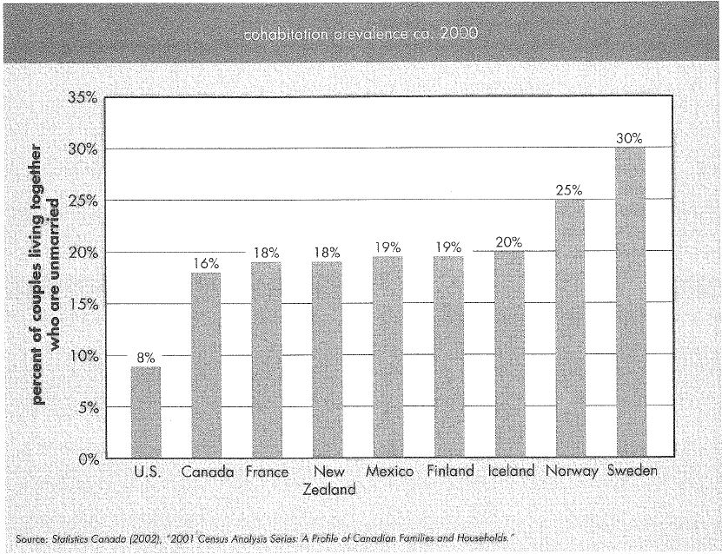
Cohabitation
Do Sociologists Ask?
How many of you have already or expect you might cohabit at some point?
Notes:
US % is still relatively small, but the number has more than doubled since 1990 and increased exponentially since 1970.
In 2009, 60-70% of the adult population between ages 19-44 had cohabited at some point. We just tend to eventually either marry or break up.

Slide 14
Sexuality
Do Sociologists Ask?
Homosexuality was defined as a mental disorder until 1973
Defense of Marriage Act (US 2004) grants married couples 1,138 rights not available to unmarried partners
The Michigan constitution bans same-sex marriage and places restrictions towards the forming of same-sex unions.
Notes:
In 2004, voters approved a constitutional amendment, Michigan State Proposal - 04-2, that banned same-sex marriage and civil unions in the state. It passed with 59% of the vote.
The Michigan Supreme Court later ruled that public employers in Michigan would not be legally allowed to grant domestic partnership benefits based on the recently passed measure.
The public opinion may have changed since 2004. A June 2009 poll showed a substantial shift in opinions towards the legal recognition of same-sex unions in Michigan, with 63.7% of residents supporting civil unions for same-sex couples and 46.5% of residents supporting full marriage rights for same-sex couples.

Slide 15
Sexuality
Do Sociologists Ask?
Human Rights campaign estimates 99% of all US counties have same-sex couples, and about 3.1 million people live in same-sex relationships.
http://video.pbs.org/video/2290302882
Morality? Whose definition?
Notes:
http://video.pbs.org/video/2290302882

Slide 16
Divorce
Do Sociologists Ask?
Rates have declined somewhat since peak in early 1980s, but still 40-45%
Affected by micro/meso/macro factors

Slide 17
Social Consequences of Divorce
Do Sociologists Ask?
Poverty among single female households
47% of parents owed child support in 2007 received full payment
25% received no payment
Long lasting affects on children
Educational attainment, health, relationships, divorce, income, occupational prestige

Slide 18
How to Limit Affects on Children
Do Sociologists Ask?
Depends on nature of postdivorce relationship
Cooperative and civil
Collaborate on behalf of children
Children remain in same home, same school, same friends

Slide 19
Questions
Do Sociologists Ask?
Do we have a crisis of family?
Would making it harder to get a divorce create stronger and healthier families? If you were making divorce policy, what would you do? What are positive and negative aspects of your policy?

