Slide 1
Quiz: Thursday, Nov. 8
Do Sociologists Ask?
Institutions, p. 277-283 in text
Chapt. 10– Family
Chapt. 11- Education & Religion
Dodson & Luttrell- Families Facing Untenable Choices (posted on Canvas, week 9)
Ecklund- Religion and Spirituality among Scientists (posted on Canvas, week 10)

Slide 2
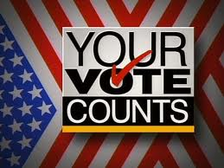
Election Day: Go Vote!
Notes:
Election Updates—
Social construction of Race
http://www.huffingtonpost.com/2012/11/03/chris-rocks-message-for-white-voters-kimmel-brooklyn-video_n_2068896.html?utm_hp_ref=mostpopular
Several ballot measures where voters have a chance to reshape or strengthen social norms by putting certain things into legal policy. The very fact that these things are on the ballot and controversial tells us that we are in a time period when the norms associated with same-sex marriage and marijuana use are unclear.
Same sex marriage in MN:
http://video.pbs.org/video/2290302882#

Slide 3
Same-Sex Marriage
Do Sociologists Ask?
Maine, Maryland, Washington state voting to legalize gay marriage
Maine would reverse outcome of 2009 ban
Minnesota voting on a constitutional amendment to ban gay marriage
Legal in six states and the District of Columbia — in each case the result of legislation or court orders, not by a vote of the people.
Notes:
Same sex marriage in MN:
http://video.pbs.org/video/2290302882#
Interesting example of changing/contested social norms and institutions

Slide 4
Legalizing Marijuana
Do Sociologists Ask?
Medical marijuana use has growing support. Legal in several states, including Michigan.
6 states voting to legalize medical marijuana
Oregon, Colorado, and Washington voting to legalize recreational marijuana use
Check out more at:
http://medicalmarijuana.procon.org
Notes:
Interesting example of changing/contested social norms and the social construction of deviant activity.
I encourage you to dig deeper into the social history of criminalization of marijuana. Its an interesting exercise in social construction of deviance. Who wins and who loses in this process?

Slide 5
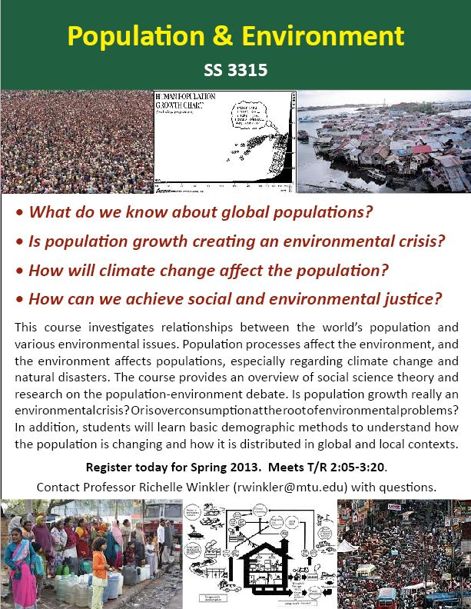
Notes:
These are two courses that I’m teaching this spring that you may be interested in. Both are for upper level undergrads. Please contact me for syllabi or with questions.

Slide 6
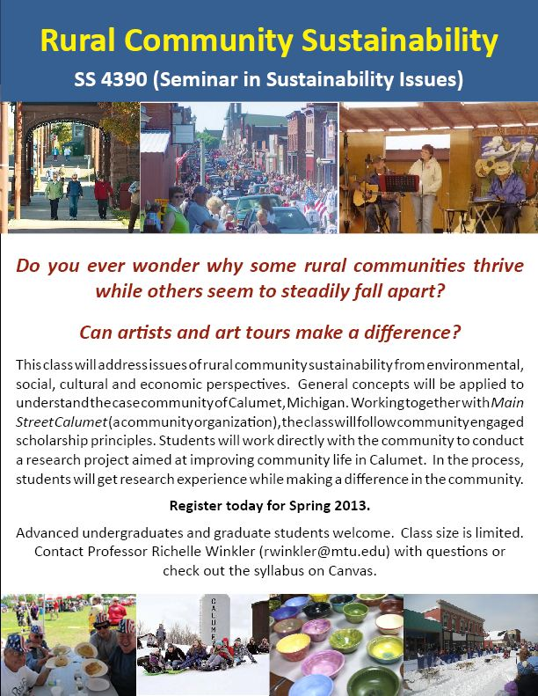

Slide 7
Project Presentations
Do Sociologists Ask?
Dec 11 & 13
Great Lakes Research Center
Copper Country Mental Health
MTU Counseling Services
Area High School/Middle School counselors and principals
Michigan Tech community– Tech Today/ Univ Communications
Dial-HELP
MTU religious organizations
General public
Notes:
We’ll meet in the Great Lakes Research Center, Room 202 for the last week of class and have presentations there.

Slide 8
Institutions: Education
Nov 6, 2012

Slide 9
What do you learn in school? - preschool - elementary school - middle/high school - college - grad/professional school
Notes:
Planned and Formalized Functions:
- Socialize children to be productive members of society
- Select and train individuals for positions in society
- Promote social participation, change, and innovation
Enhance personal independence and social development
Credentialing system that speaks to employers
Unplanned and Informal Functions:
Confine and supervise underage citizens
Weaken parental controls over youths
Provide opportunities for peer cultures to develop
Provide contexts for the development of friendships and mate selection

Slide 10
Key Points
Do Sociologists Ask?
We learn a lot more in school than just educational curriculum
Socialization (language, culture, roles, norms, values)
Sense of self: 1st opportunity for success or failure
Education is extremely important for individual success in society but also for society as a whole to have an educated citizenry
Social order
Economy
Democracy
Health care
Social services (prisons, welfare, etc.)

Slide 11
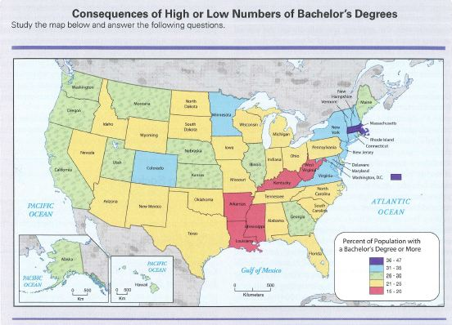
Notes:
Map p. 331
How might the economy of a state be affected when an especially low % of population has a college degree?
What kinds of businesses are more likely to locate in a state with a very high % college educated?
How might politics, the health care system, or science be influenced by high or low levels of education?
Look at the states that have especially high or low levels of college degrees. What might be some of the causes? What might be some consequences?

Slide 12
Special Topics
Do Sociologists Ask?
Schools are vital for communities (pride, unifying symbol, services, relationships)
Popularity/Bullying in school shapes our social relations and sense of self
31% of gay youth threatened or injured at school each year
ESL hugely important and growing, though not always politically popular
Schools are bureaucratic systems
Education is a system of credentialing
Education is vital for health and development around world

Slide 13
Politics in Schools
Do Sociologists Ask?
Schools are bureaucracies, closely linked to government bureaucracies
Each president since 1965 has put mark on US educational system
State superintendents
Rules and systems change
Politicians make decisions as much as teachers
Funding

Slide 14
Does education enhance upward mobility and serve both individuals and society, or does it mostly serve the affluent, reproducing social class and training people to fulfill positions at the same level as their parents?
Notes:
Education is supposed to be a meritocracy whereby people are allocated to positions according to their abilities and credentials. Is this really the case? How so? How not?

Slide 15
Sources of Inequality in Education
Do Sociologists Ask?
Testing
Tracking
Funding
Educational climate in schools varies with culture, teachers, administration, higher politics
Public vs. Private schools
Vouchers and school choice
Gender Inequality

Slide 16
Testing
Do Sociologists Ask?
What factors affect ACT/SAT test scores?
Have your scores affected your life chances?
Are there ways in which you have been privileged or disprivileged in testing process?
Questions, language differences, and testing situations are biased against lower-class, minorities, and immigrant students

Slide 17
Tracking
Do Sociologists Ask?
Reinforced achievement levels and self-fulfilling
Affect preparation for the next level
Levels correlate directly with factors such as class background and ethnic group, language skills, appearance, and other SES variables
Friendship circles reinforce social networks

Slide 18
Funding & Climate
Do Sociologists Ask?
Affects types of programs, learning atmosphere, teaching quality

Slide 19
A Tale of Two Schools
Do Sociologists Ask?
https://www.youtube.com/watch?v=5xdfVAPvv9A&feature=related

Slide 20
Additional Sources
Do Sociologists Ask?
https://www.youtube.com/watch?v=R09EfxHuIXA&feature=relmfu
https://www.ted.com/talks/lang/en/ken_robinson_says_schools_kill_creativity.html
https://www.youtube.com/watch?v=9TXeUldd8Ak
https://www.youtube.com/watch?v=_Z-6BZJ39qE
Notes:
These are additional videos related to sociology of education that you may find interesting.

