Slide 1
Population and Environment
Nov 29, 2012

Slide 2
I have lost my voice so that its difficult for me to talk well. I will do my best, but may need to whisper. If you have questions, come up to me and ask.

Slide 3
We have a visitor in class today. She is Professor Mary Durfee. She is here to evaluate me and my teaching. Talk to her if you wish or if she has questions for you, but she is mostly here to quietly observe.

Slide 4
Moka tells me you have some questions about components of course: 1- Participation 2- Final Paper 3- Suicide Presentations

Slide 5
Final Paper: Description posted on Canvas. I will add a little more detail, but there is already good description there under Assignments. It will be graded using rubric in syllabus.

Slide 6
Suicide Presentations: 12/11: Practice in Class 12/13: For public in GLRC Each group elect 1-3 people to speak. All should help prepare. Each group no more than 10 minutes. I will give more instruction on Tuesday.

Slide 7
Discussion 7: Class today will mostly be you all working in groups on Discussion 7. I will provide a brief introduction. ANY QUESTIONS?

Slide 8
Population 7 Billion
7 Billion in 2011
By 2045 global population is projected to reach 9 billion.
How did we get to this point?
Can the planet take the strain?

Slide 9
Notes:
History of the World’s population
From emergence of man to present- 1975

Slide 10
Notes:
Introduction of Ag

Slide 11
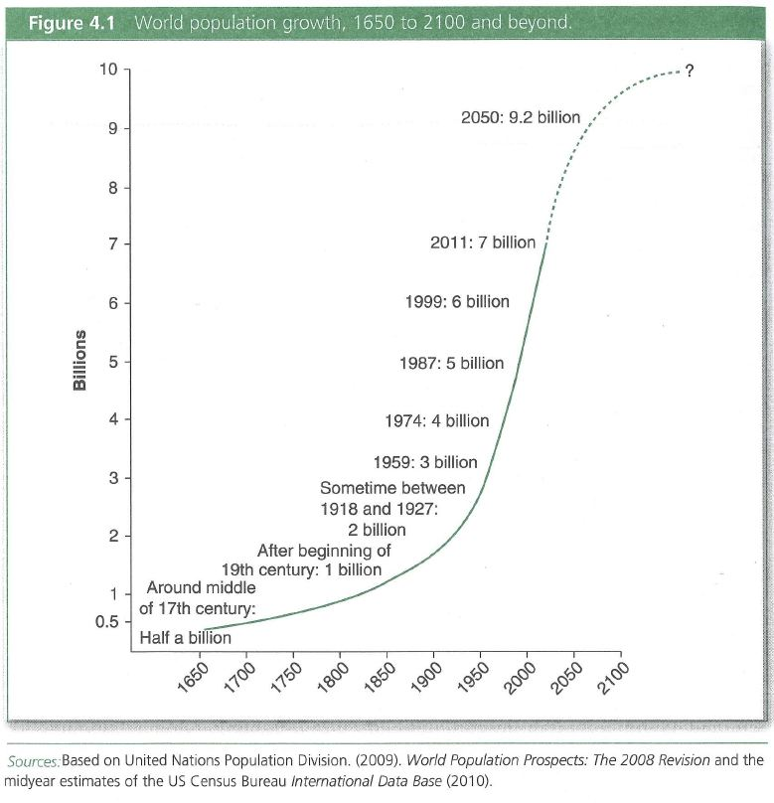
Notes:
Industrial revolution
Population growth is a very recent phenomenon in terms of history of man

Slide 12
Sources: UN Population Division and Population Reference Bureau.

Slide 13
Why the Growth Explosion?
Do Sociologists Ask?
Mortality declined
Ag, Health, Education, Technology
Declined everywhere but still much higher in some places
Fertility declined later
Still high in some areas of world (TFR 1.7 – 4.5 in 2010)
Gap between mortality and fertility decline= GROWTH
Population momentum continues growth

Slide 14
Population Momentum
Do Sociologists Ask?
Growth that occurs even after fertility declines to replacement (2.1 births/woman)
Because of young age structure
Source: UN Population Division, 2008

Slide 15
Can the planet support it?
Do Sociologists Ask?
Finite planet with some limits to growth
More people could mean more resource use, pollution, etc.
Higher consumption also degrade env
Human ingenuity pushes limits

Slide 16
We are facing global Climate Change. This is a social and environmental issue. 1- Why do we continue to emit increasing gases? 2- How might we address the problem?

