Slide 1
Social Change
Dec 4, 2012
Notes:
http://www.youtube.com/watch?v=g032MPrSjFA
Thursday: cover theories of change and unplanned change (riots, etc.)

Slide 2
Can the planet support it?
Do Sociologists Ask?
Finite planet with some limits to growth
More people could mean more resource use, pollution, etc.
Higher consumption also degrade env
Human ingenuity pushes limits
Notes:
Reflect on group discussion project from last week. Role of population growth, consumption in global north, emerging economies in contributing to climate change.
1- This is a really complicated problem.
2- I didn’t set this up for there to be any “right” answer. What do you all think is the right answer? Why?
3- There is solid evidence that each of these is an important contributor.
4- In reality most sociologists would agree that all are important, but some argue that population growth is NOT important– blame the victim.

Slide 3
The only thing consistent is change.
Notes:
From Chapter 1, processes of change are inevitable features of groups and societies. To survive, groups and societies must evolve and change in response to changes in the broader social and physical environment.
When we talk about social change, we mean variation over time in the structure (institutions), culture (norms and values), and behavior patterns in society.

Slide 4
Powerful social structures constrain what we do, but they can never control entirely. Human beings are not passive actors. Individuals acting alone, or with others, can shape, resist, challenge, and sometimes change the social structures that impinge on them. These actions constitute human agency.
Notes:
We’ve learned about a lot of problems and issues in society this semester. And we’ve learned about the ways in which our choices as individuals are limited and shaped by larger social structures. This can be depressing, but the good news is that YOU CAN MAKE A DIFFERENCE!

Slide 5
Durkheim— “Sociology is not worth a single hour’s work if it does not help change the world for the better.”
Notes:
As we start to wrap up this semester, I hope that you have learned some things in this course that will help you contribute to the dialogue about how to make our social world a better place.
The Living Better paper option for your final paper is meant to give you an opportunity to think through how sociological insights can help us to address a social problem.

Slide 6
Read this Chapter!
Do Sociologists Ask?
How to be an effective leader
How to understand and counteract rioting or other dangerous collective behavior
Understand processes of global development
How can we facilitate positive change in society?

Slide 7
Strains and Stressors
Do Sociologists Ask?
Strain
Internal contradictions
i.e., inequality
Stressor
Pressures for change from outside
i.e., climate change
Notes:
Organizations as unit

Slide 8
What Spurs Social Change?
Do Sociologists Ask?
Environment
Science & Technology
Leaders
Top Down: through policy
Bottom Up: collective action
Population dynamics
Changes at other levels (micro-meso-macro)
Major events/crises
Wars/acts of terrorism
Economic crisis
Natural disasters

Slide 10
Planned Change
Do Sociologists Ask?
Planning
Strategic planning in organizations
Urban and regional planning
Including participants (workers, community, etc.) in planning is key to buy-in
Social movements
Organized attempts outside of established institutions to enhance or resist change through group action

Slide 11
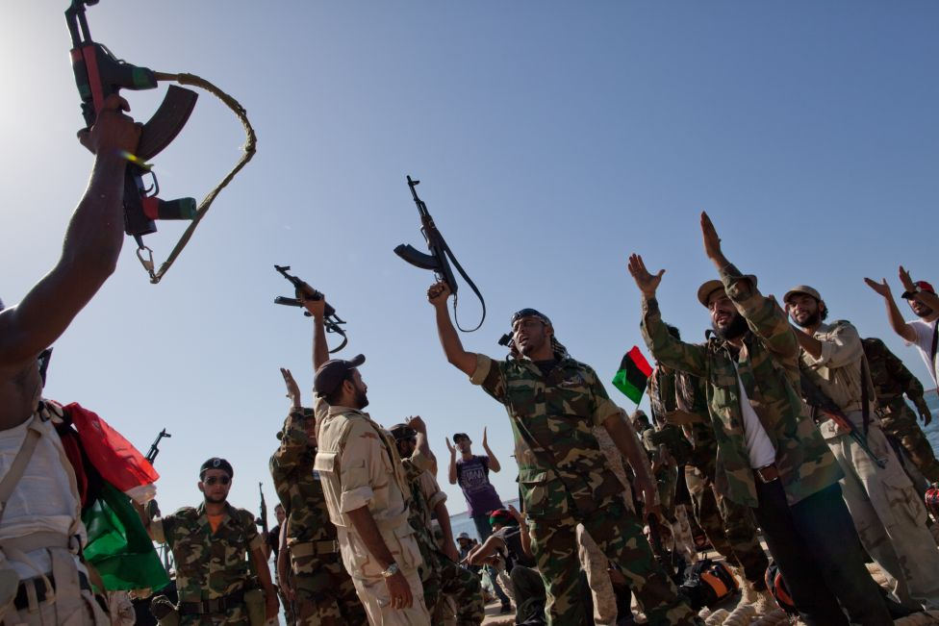
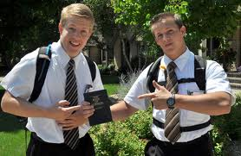
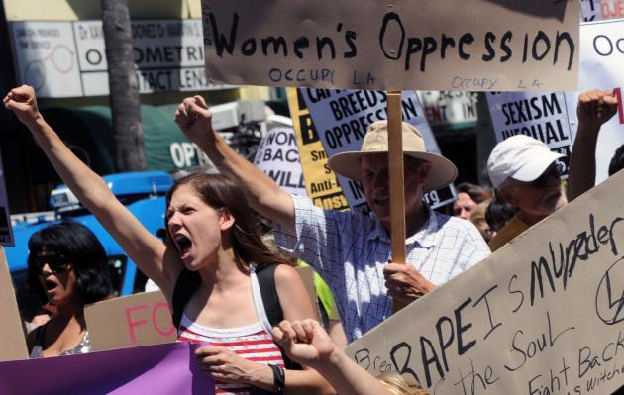
Social Movements
Do Sociologists Ask?
Expressive
Religious missions
Self-help, healing, etc.
Aimed at micro level
Social reform
Change some aspect
Meso or macro level
Specific issue (women’s rights)
Revolutionary
Major transformation
Arab spring

Slide 12
Your Expressive Adventure in Social Change: Discussion 6
Do Sociologists Ask?
Movement to break down “us” vs “them” thinking
Positive interactions is key
Tell about your experience
What did you learn about the unfamiliar group?
What did you learn about yourself?
Do you think this experience had any impact of breaking down “us” vs “they” thinking inside of you? Of the group members you interacted with?

Slide 13
Resisting Change
Do Sociologists Ask?
Protect the status quo
Potential disruption to larger functioning of society
Institutions don’t like change
Counter-movements
Regressive social movements
Social pressure against working for change
Unintended consequences

Slide 14
An Example: Women in Science
Do Sociologists Ask?
Women remain underrepresented in science
Lack of interest/Image? Gender Bias? Innate differences?
Yale Study shows lingering bias at grad school level
Movement to increase women’s involvement in science
http://www.youtube.com/watch?v=g032MPrSjFA
What do you think of this approach?

Slide 15
Suicide Presentations: 12/11: Practice in Class 12/13: GLRC, Room 202 Official announcement out today. Each group elect 1-3 people to speak. All should help prepare. 20 slides @ 30 seconds each.

Slide 16
Presentations
Do Sociologists Ask?
20 slides at 30 seconds each
Limit words– charts and pictures
I will put together a brief intro on extent of problem
You focus on
Optional to elaborate on extent of problem if makes sense for your project (special comparison you did, etc.). But brief.
Social explanation you chose to address. Why is it appropriate to address this issue? Describe evidence.
Product you suggest. Why is this a sound product idea? Why should the community members present consider really doing this?
Note limitations of study

Slide 17
My Intro
Do Sociologists Ask?
Copper Country young person suicide rates indicate problem is pretty typical
High school and middle school survey data indicate significant proportions of students in the local area thinking about suicide.
Suicide is related to many factors (including biological, psychological, and social ones). In this class we focus on social factors.
Social factors can be addressed by communities and organizations.
Don’t expect perfect answers from these students. But…they have worked hard and they have some good ideas.

