Slide 1
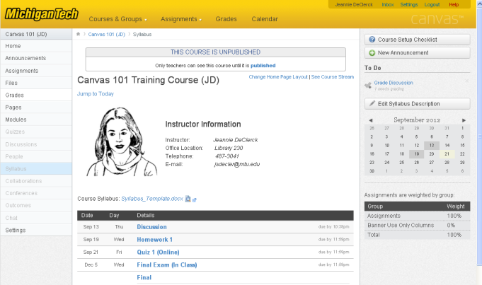
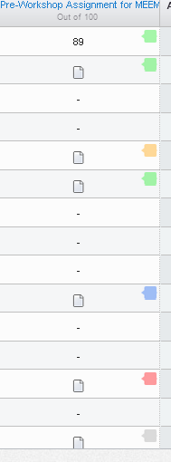
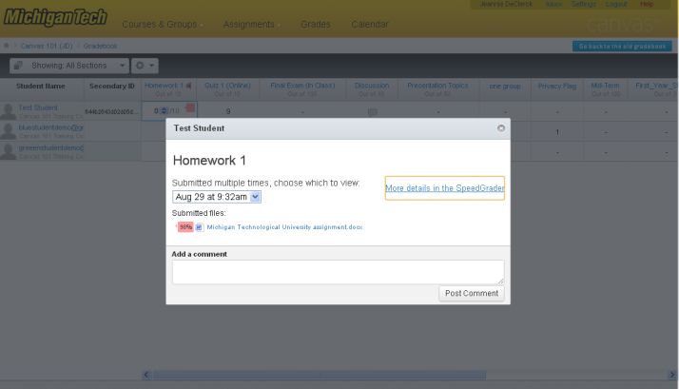
Turnitin for Canvas Assignments
Click on Grades in course tools menu
Turnitin feedback bubbles will be visible in the assignment column. Different colors correspond to different percentages
Click the colored feedback bubble for a Turnitin enabled Assignment
Click More Details in Speedgrader

Slide 2
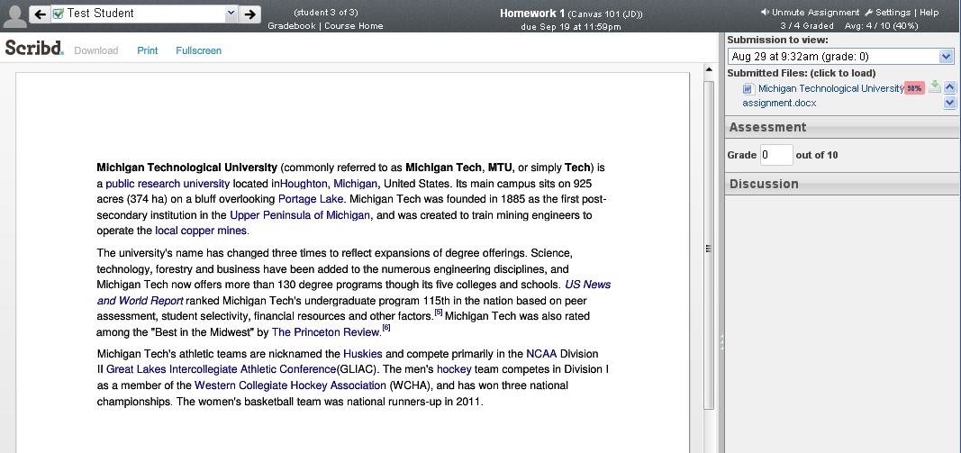
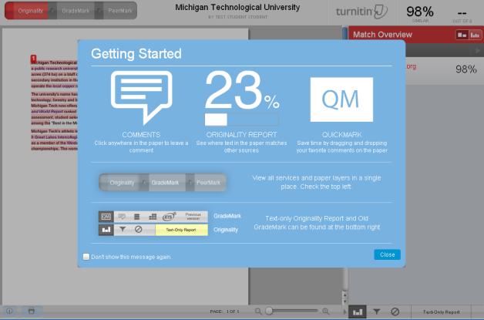
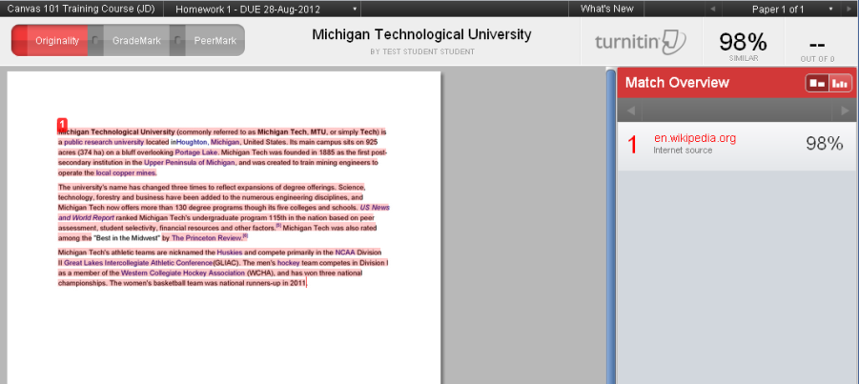
Note: This example document was copied from Wikipedia
Click on the feedback bubble which will probably have a percentage (%)
Click Close to see the report

Slide 3
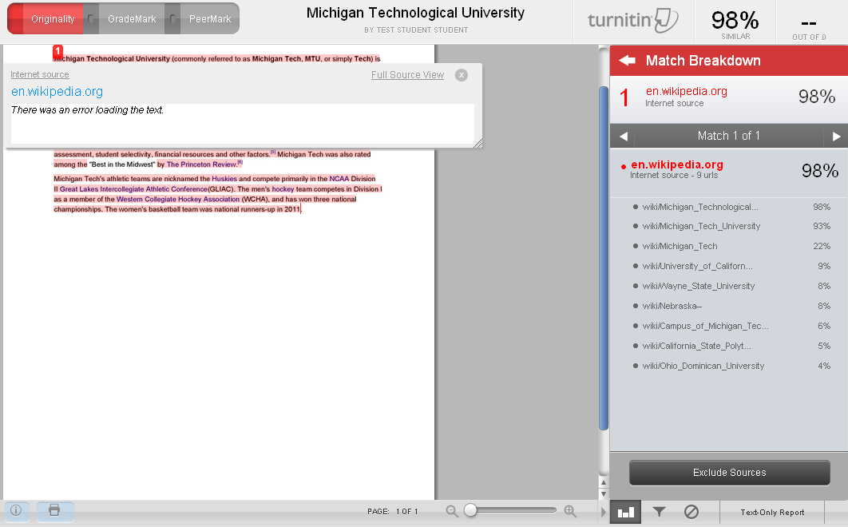
Hover on one of the matches and click on the arrow icon
The original source or a link to this course will appear in a window
Note: You can choose to Exclude Source

