Slide 1
Doing Sociology: - Suicide: A personal trouble? - “Natural” Disasters? - Sociological Theories
Jan 21, 2014
Notes:
Canvas
http://www.asanet.org/introtosociology/Documents/PuzzlesAndTheory10.html
http://sociologysource.squarespace.com/sociologysounds/2012/2/14/society-eddie-vedder.html
Why this song?
Society affects our lives in personal ways
Can we separate ourselves from society?
Have to “remove” ourselves to think critically about society
Last week defined the sociological imagination and gave you all some practice at thinking through how things that we often experience as personal are actually shaped by society. That is what the sociological imagination is all about. It is called the imagination because it’s about the way we think about the world and our individual experiences.
Today, I want to review a couple of examples of phenomena that we often think of as NOT being social, and think about how even suicide and natural disasters are shaped by social forces. I also want to spend some time talking about sociological theories.

Slide 2
Key Concepts Review
Sociological Imagination— a way of thinking that connects individual troubles to public issues.
Social structure—social forces that shape our lives
Agency—individuals do make choices and have free will
Social institutions—provide the rules, roles, and relationships to direct and control human behavior
Notes:
Individuals and the social world mutually influence one another.

Slide 3
Social Forces in Your Life
Activity Posting 1
Notes:
Activity Posting 1 due today. Share an issue you wrote about.

Slide 4
Suicide– A personal trouble?
Do Sociologists Ask?
Suicide rate varies across place and culture
Why do people commit suicide?
How individuals fit into society and social relationships are part
How we think about and handle suicide is social
Michigan Tech Counseling Services
http://www.mtu.edu/counseling/
Or call at 487-2538
Dial Help
http://dialhelp.org/
482-HELP
Notes:
I want to spend some time talking about suicide because its one of those things that we think of as being intensely personal, not social. Also, because this is a major issue that has likely touched many of your lives in some way, and so I think it is something that you’ll have some interest in.
At the same time, I want to recognize that talking about suicide is hard and it may bring up some difficult feelings. For this reason, I’ve included some resources for learning more about suicide prevention and what to do if you or someone you know is thinking about suicide on Canvas. I would also highly encourage you to contact MTU counseling services if you or someone you know is thinking about suicide.
Although suicide is intensely troubling for individuals, their family and friends (a private trouble), the suicide rate, reasons for suicide, and relations to and expectations about suicide are very closely related to the way society is structured and to issues facing society.

Slide 5
Suicide affects most of us
Do Sociologists Ask?
Worldwide: 1 million suicide deaths a year
Over 36,000 people in the US die by suicide every year.
8 to 25 suicides are attempted for every suicide death.
4th leading cause of death for ages 18-65 in US
3rd leading cause of death ages 15-24
2nd leading cause of death among college students
According to National College Health Association survey, about 8% of college students in 2011 had at some point made a suicide attempt, and 20% had at some point seriously considered suicide. 7% had considered within last year.

Slide 6
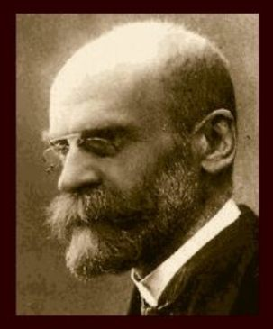
Durkheim– Father of Sociology
Do Sociologists Ask?
Emile Durkheim
(1858-1947)
Made case for sociology as a science
Le Suicide (1897)
One of his major works
Used study of suicide to demonstrate importance of sociology
Notes:
Durkheim formally established sociology as a discipline of study.
One of his major works (Le Suicide) analyzed suicide from a sociological perspective.

Slide 7
Durkheim’s Study of Suicide
Do Sociologists Ask?
Private…but… SOCIAL
Approach: Statistics and comparative
Examined and explained variations in suicide rates amongst different groups and cultures
Finds stats to correlate with social phenomena (family, political and economic society, religion), rather than biological or weather-related phenomena.
The totality of suicides is topic of investigation, not individual suicides (Macro)
Suicides (private trouble) occur within social context (public issue)
Notes:
Why does Durkheim study suicide?
He chose suicide, because his main point was to demonstrate the importance of sociology, even more than really learning anything about suicide in particular. So, he chose suicide because it was something that was widely presumed to be very private. People were thought to commit suicide because of biological mental illness, climate, and weather – things that are not social. Durkheim took up the challenge of disproving that these asocial things explain suicide rates. He used a process of elimination to disprove nonsocial explanations (mental alienation, race, heredity, climate, temperate, and imitation). Instead, Durkheim finds that suicide rates correlate with social phenomena, including: family, political and economic society, and religion. Thus, he makes the case for needing sociology.
In other words, Durkheim illustrates that this very private issue (suicide) is, in fact, social. It demonstrates the importance of sociology, because if something so private as suicide is really sociological, then everything is.
Today, sociologists might take many different approaches to studying suicide. We could study it at the micro level (looking at impact of small group interactions), the meso scale (examining community institutions) or the macro scale comparing rates across societies and cultures around the globe. Durkheim takes this macro scale approach. This means that he is not interested in explaining why individual people commit suicide, but rather on explaining the totality of suicides in a society (the suicide rate).

Slide 8
Durkheim’s Theory of Suicide
Do Sociologists Ask?
Egoistic (Weak Bonds)
Lack of integration of individual into society/family
Occurs in more individualistic societies
Altruistic (Strong Bonds)
Sacrifice for the good of the whole
Societies governed by custom or obedience (traditional cultures, military)
Notes:
Durkheim collected data on suicide rates for different groups and societies by country, gender, religion, etc. He compared rates to one another and he examined how they vary in relations to social variables (religion, family, political and economic organization, etc.).
As he examined all of these data and began to find correlations, he needed to be able to explain how/why social factors explain suicide. To do this, he developed a theory that would explain variation in suicide rates between social groups. He then tested this theory as his hypothesis by further reviewing the data to make sure the theory holds. The theory he came up with is that there are four different types of suicide, each of which is more of less common among different groups and societies. These are Durkheim’s social explanations for suicide. The four types include: egoistic, altruistic, fatalistic, and anomic. They are explained in this slide and the next one.
Egoistic suicide is common in societies that are highly individualistic and have weak social bonds. The US and Australia are these kinds of societies. The trouble here is that individuals are not well enough integrated into the social fabric of life. They are not well enough connected.
Altruistic suicide is the opposite. It is common in societies with very strong social bonds and little regard for individual needs. Here, people commit suicide for the good of the whole. For instance, if there is not enough food for all to eat, one member may commit suicide to ensure that others in the community have more to eat. Another example is suicide bombers who sacrifice their life for a communal cause they believe deeply in.
So…weak bond societies may have some problems, but strong bond societies may also. For instance, in a research study, Henry and Short (1954) fond that suicide rates are lower in cohesive groups, but homicide rates higher.

Slide 9
Durkheim’s Theory of Suicide
Do Sociologists Ask?
Fatalistic
Oppressive conditions
Slavery, sentenced to death, fatal illness
Anomic
Rapid change in social position produces discord within self and understanding of social role. Unable to cope with change
Modernity
Divorce, fast economic rise or fall
Notes:
Durkheim’s other 2 types are fatalistic and anomic.
Fatalistic suicide is common when people feel they are so doomed by social conditions, they may as well die. It is common among heavily oppressed groups.
Anomic suicide is associated with social changes associated with modernity/industrial life. Durkheim lived at a time where life was rapidly transitioning away from rural agricultural society toward industrial urbanization. He was critical of these patterns. He believed that anomic suicide occurs when social life changes so quickly that people cannot cope. It would be expected in societies undergoing a lot of change, or in societies where everyday patterns are disrupted by things like divorce, job loss, etc.

Slide 10
Durkheim’s Theory of Suicide
Do Sociologists Ask?
Different societies/groups have different kinds of social bonds. This explains variations in suicide rates.
Social integration
Norms/anomie
Social factors affect individuals’ degree of integration and sense of fit– moving, age, religion, divorce, social change, homosexuality, political organizing
High suicide rates signify a flaw in the social fabric
Notes:
This slide summarizes Durkheim’s theory.
The key factors here are (1) social integration (weak bonds/strong bonds, connectivity) and (2) norms. Social integration is key because human interaction is so important to individuals. We NEED our social connections. Lack of norms can erode the ties of the individual to society. These factors are still very important explanations of suicide today.
Social factors can affect individuals’ and societies’ degree of social integration and thus tend to be correlated with suicide rates: moving, age, religion, divorce, social change, homosexuality, and political organizing.
In the end, we might think of the observation of high suicide rates as signifying a flaw in the social fabric. In this sense, suicide tells us something about our society. It could be thought of as a kind of warning sign that there are things we need to work on.

Slide 11
What State in US has highest rate?
Montana- 22.5
Alaska- 20.5
Wyoming- 20.4
Idaho- 19.7
Nevada- 19.1
Wisconsin- 12.8 Michigan- 11.7
New York- 7.3
New Jersey- 6.4
Washington DC- 4.8
Notes:
Data in the map are from National Institute of Mental Health website, which uses data from US Center for Disease Control, which keeps tracks of mortality statistics.
Data on right are from 2009. Montana is highest. Montana through Nevada are the top 5 highest rates. Washington DC is lowest. New Jersey and New York are second and third lowest. Michigan does pretty well (around 15 lowest). Wisconsin is only a little higher.
Thinking sociologically, how might we explain these patterns in the data? Think back on the theories we’ve been reviewing. Do any of these theories seem consistent with these rates?

Slide 12
Which country do you think has the highest suicide rate?
Notes:
Which country in the world do you think has the highest rate? Why would that be the case?
Which country do you think has the lowest rate? Why?

Slide 13
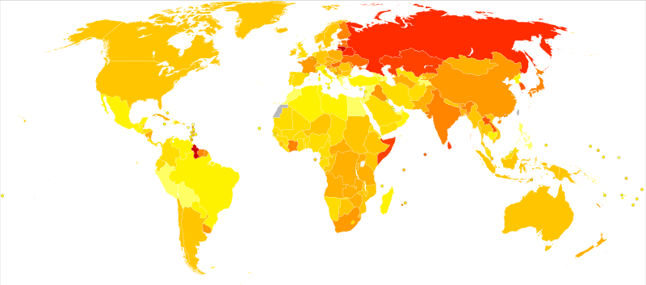
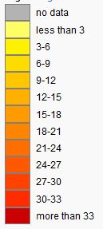
Source: World Health Organization, 2011
Notes:
Did you guess correctly this time? Did you have the right general idea?
What is surprising? Why?
The next slide includes the numerical data on some high and low suicide rate countries.

Slide 14
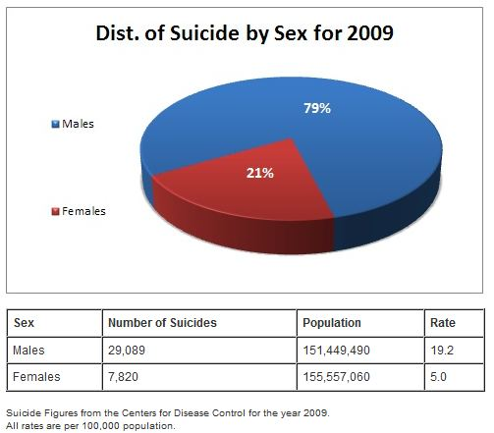
Notes:
Going back to the US only now. Let’s look at suicide rates for different social groups.
This slide shows rates broken down by sex.
How might we explain these patterns? What is it about society that makes male rates so much higher than females?
We’ve learned from readings that although male deaths from suicide are much higher than females, females are more likely to attempt suicide. Why might this be the case? Think sociologically, and keep thinking about those multiple levels of influence.

Slide 15
Book Clubs
Leaders and Notetakers
Jan 23- Chapt 1
Feb 6- Chapt 2
Feb 20- Chapt 3
Feb 27- Chapt 5
March 6- Chapt 6
April 10- Chapt 7
April 22- Chapt 8
Notes:
Responsibilities when you are Discussion Leader:
1- Summarize reading. In about 2 minutes summarize what this reading was all about, noting the key themes and key issues.
2- Pose questions. Come with a list of about 5 questions that you want to pose to group to discuss.
3- Key passages. Identify 1-2 key passages that you found particularly interesting, raised issues, important, etc. Read the passage to the group, then discuss amongst the group. Use the passage to spur group conversation.
4- Engage others. Make sure that everyone in your group has something to say. Ask direction questions if need be, "Hey Joe, what did you think about that passage?" Give everyone opportunities to participate and keep the discussion going.
Responsibilities when you are Notetaker:
1- keep notes during the discussion
2- further develop notes after class
3- post notes to Canvas discussion thread

Slide 16
Natural Disasters
A natural disaster is an “act of God”, right?
What did you read about for today?
How is Hurricane Katrina social?
Are there any natural disasters?

Slide 17
What is theory?
Ways of thinking about the world
Make sense of what we experience
Sometimes competing
Big picture
Mid-range

Slide 18
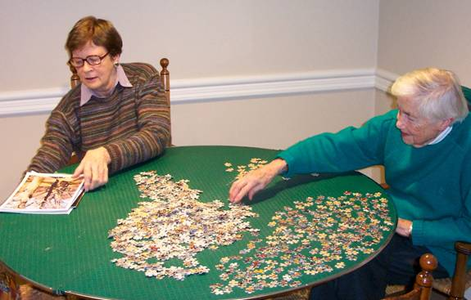
What is a theory?
Social theory provides frames of reference for organizing data so we can forge order out of chaos. Helps us to make sense out of bits of data we gather in everyday life.
Notes:
http://www.asanet.org/introtosociology/Documents/PuzzlesAndTheory10.html
Analogous to strategies for making a puzzle
What is the first thing you do when you put together a large difficult puzzle?
When faced with a large number of seemingly unrelated pieces, need some basis for organizing them.
Sort by color?
Find edge pieces?
Look at picture on box?
Social theory also helps us to forge order out of chaos. Theory provides frames of reference for organizing data. It helps make sense, or meaning, out of all those little bits of everyday life.

Slide 19
Where does theory come from?
We all have theories
Sociological theories
Specifically and systematically developed
Built on scientific research and prior thinking
Focused on structural relationships (social forces)
Notes:
Everyone creates theories to help them make sense of what they experience.
Common-sense theories
Tend to be less systematic
Sociological theories: specifically and systematically developed
Typically built on the theories and ideas of previous sociologists.
Built on scientific research (desire to share--publish-ongoing dialogue)
Focused on structural relationships (individual in society, human being as social being), rather than "personal experiences."
Personal concerns directed toward understanding social issues.

Slide 20
Big Picture Sociological Perspectives
Functionalism
Pieces of society all work together
Conflict
Some winners and some losers- power is key
Symbolic Interaction
Interpersonal relationships and interactions shape the social world

Slide 21
For Thursday…
Read Methods – Chapt 2 in Conley
Read Chapt 1 in Gang Leader for a Day
Prepare for Discussion Groups

