Slide 1
Qualitative Analysis
Jan 30, 2014
Notes:
Video of mitch dunier

Slide 2
Next Week
Activity Posting 2 due before midnight Jan 31
Chapt 2 in Gang Leader for Day for Tues.
Myth of Individualism Chap 1 for Tuesday
Quiz 2 on Canvas before midnight Wed
  Two methods readings for this week on Canvas
  Myth of Individualism Chapt 1
  Class notes Tuesday, Feb 4

Slide 3
Qualitative Analysis
Understand the context
  How and why things come to be
Deeper meanings
Examples
  Trust government? Environmental concern?

Slide 4
What is ethnography?
Immersion
Investigative journalism
“portrait of the people”/ “walk in the shoes”
“describes and analyzes the beliefs, motivations, and rationales of a people in a particular setting or subculture.”

Slide 5
Data Collection
Do Sociologists Ask?
Participant observation
Semi-structured or open-ended interviews
Oral histories

Slide 6
Issues with Field Work
Time
Preconceptions
Gaining trust– getting behind fronts
Ethics: deceit, harm?
Misunderstandings
One-sided/piece of the story
  Talk to wrong people
“Going native”
Getting too close/getting involved
Peer review
Reinforcing stereotypes
Notes:
Mitch Dunier video

Slide 7
Is ethnography science?
Include voices of full spectrum
Systematically compare data to theory
Triangulation
Report methodological reflections
Only access to hidden, secretive populations
Challenges, extends, or creates new understandings

Slide 8
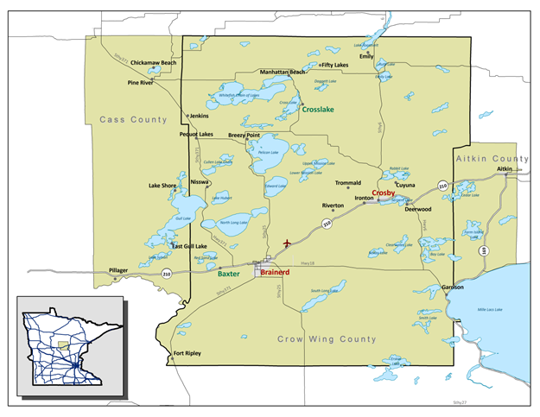
Doing Social Science Research…Examples
Do Sociologists Ask?

Slide 9
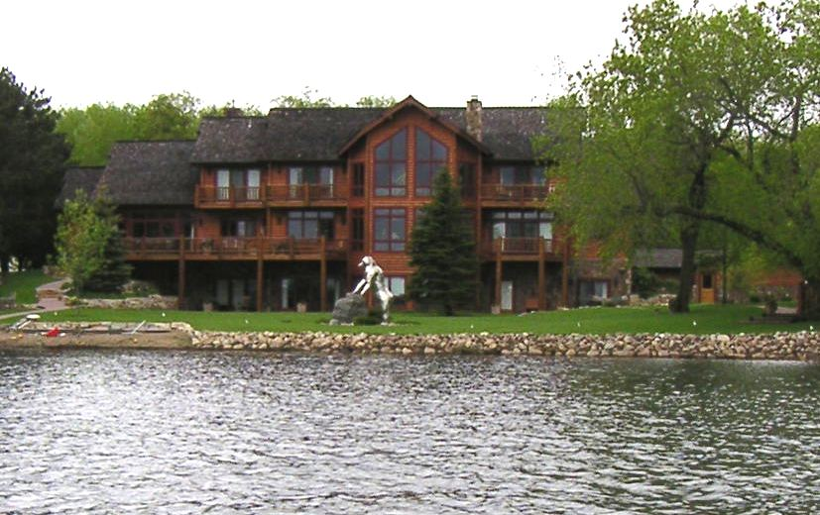
Living on Lakes
DOES DESTINATION DEVELOPMENT PROMOTE COMMUNITY OR SOCIAL EXCLUSION? HOW?
Notes:
The more specific piece of my dissertation that I want to talk more about today is based on an intensive case study of Minnesota lakes destination area. This case study focused on understanding how destination development impacts community well-being.
Now, there are multiple ways that destination development (or mining or any other kind of environment/resource development) might affect community sustainability/well-being. I specifically focus here on the social interaction and distributional aspects of well-being, thinking about those who might be left behind in the context of growth.
My driving question is: “ Does destination development promote community or social exclusion? And how?
What is “community”?
There are multiple definitions of community, and so I want to clarify here that I am talking about a feeling-based conception of community that evaluates the degree of social integration within a place-based community. So, this is a study of community where the issue of interest is the relationship between destination development and community itself.
What is “social exclusion”?
Social exclusion is the evil alternative to social integration. It is a broad concept referring to the fact that different groups and individuals do not have access to the same opportunities for success in life for a variety of reasons (economic and social) and subsequently, some are excluded from full participation in social life. The outcomes of social exclusion are important because being excluded in itself, is alienating. At the same time, social exclusion has instrumental importance in that it may lead to additional problems (e.g. restriction from economic opportunities and/or social capital, criminal behavior, or mental health problems).
I’ll tell you now the answer– I find that DD promotes social exclusion, particularly of lower income people and younger adults. So, let’s focus on the process through which this happens.

Slide 10
Methods & Data
Data collected 2006-2009
Interviews with key informants
Community-based research
Focus groups with lower income younger adults and service providers/volunteers
Participant observation
Quantitative data supplements qualitative findings
Notes:
So… we have a situation where the county has experienced aggregate growth, but there are still some economic problems, particularly among younger adults. How does this happen?
Quantitative data from the US Census Bureau, the State of Minnesota Auditor’s office, Minnesota local area unemployment statistics, the Minnesota Department of Education, and a local social capital survey (Brainerd Lakes Area Social Capital Survey 2007)

Slide 11
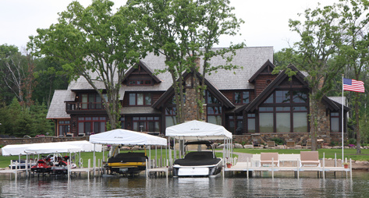
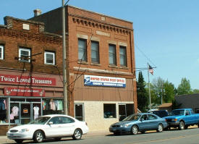
Residential Segregation by Income & Age
Its hard to realize there’s poverty here when you’re surrounded by million dollar homes. You’re in Baxter or on the lakes where everything’s shiny and you never go to downtown Brainerd where everything’s falling apart.
Notes:
In past, population was clustered in small cities. Over last 30 years new housing development has almost entirely been in the lakes areas or in more rural townships. The population has dispersed and the stock of newer and nicer housing has moved to the countryside and lakes communities.
CLICK
It is a measure of success to live on a lake, for amenity migrants, seasonal homeowners, and even for local people. People with money and status live on the lakes, not in town. Middle class increasingly living in more rural areas outside of town, if cannot afford lake property.
CLICK
Amenity development segregates rural places by socioeconomic status so that people who can afford to live near the source of the amenities in “communities of choice” (on the lakes) while lower income people and younger people become increasingly concentrated in the small city centers “communities of fate”.
Because most of the more affluent people are older, this process ends up segregating the area by age as well as income. So that younger people are concentrated in the small city centers. Poverty is hidden and ignored by more well-to-do area residents. As one of the participants in my study put it…

Slide 12
Divided into Haves and Have Nots
Notes:
Table quantifies residential segregation by age and socioeconomic status within Crow Wing County in 1990 and 2000.
Communities on left, Census data from 1990 and 2000 along the top
compares the distribution of specific populations (such as young adults (age 18-34) to the distribution of total population.
Ratios are calculated as the percent of aggregate county young adults found in each municipal type divided by percent of total county population residing in the same municipal type.
A value of 1.0 indicates that the variable is distributed exactly proportionately to total population. Values above 1.0 signify high concentrations, while values closer to zero signify low concentrations.
First, I want to call attention to the housing structure. Rental housing heavily clustered in Brainerd, Crosby and the other historic communities. Owner occupied housing values, heaving concentrated around the lakes and in Baxter.
Indicators of high socioeconomic status (income, education, and housing values) are disproportionately concentrated in the Lakes Districts (including the city of Crosslake as an example of a single lake community) and away from the small cities. For instance, in Brainerd the 2000 income ratio is 0.80. This indicates that income is 20% lower than it would be if household incomes were distributed proportionately across county municipalities. Poverty, on the other hand, is highly concentrated in Brainerd—76% higher than it would be given proportionate distribution. Public assistance income (indicating socioeconomic need) is even more concentrated in the small cities, and Crosby’s proportion is more than twice what would be expected from a proportionate distribution.
Residential segregation along each of these dimensions intensified between 1990 and 2000, during a period of substantial population and economic growth. Data for 2010 not yet available, but other data sources and qualitative data suggest that segregation became more stark in recent years than the increase 1990-2000.

Slide 13
Narrow Conceptions of Community
Our community has changed from… if you said ‘where are you from?’ Well I’m from Crosby, or I’m from Ironton. And people still do that. But now that community has changed so much…your community is the lake you live on. Where you from? Well I live on Rabbit Lake. I live on Gull Lake. I live on Mille Lacs. [For a lot of people] their communities have now been formed more along the lakes…The lakes become the communities.
Notes:
At the same time, peoples’ definitions of community have become more narrow. Pause….
In the end, the broader area is thus divided into several geographically small functional communities and municipal government units between which there is little social connection. People do not feel social responsibility for the “others” who live outside of their “community.”
Geographic and social distance limits opportunities for trust building and for people to establish mutual relationships across socioeconomic and age divides.

Slide 14


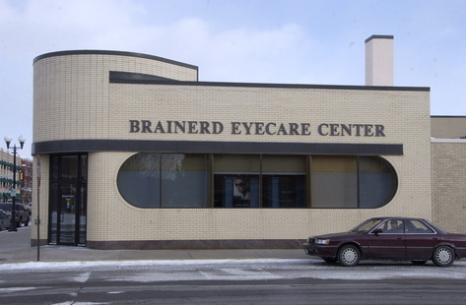
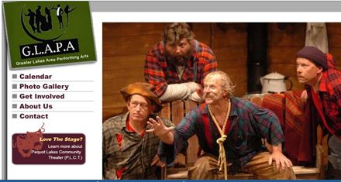
Narrow Communities Support Narrow Interests
Lakes communities support:
  Arts
  Environment
  Specialized health care
Notes:
Beyond disparities in municipal spending, county level government and non-profit efforts are also reflect lake community interests. Affluent lake community interests out-compete lower income and younger adult interests in gaining political and financial support for initiatives that benefit their interests.
Lake community residents tend to support: arts, environment, specialized health care

Slide 15
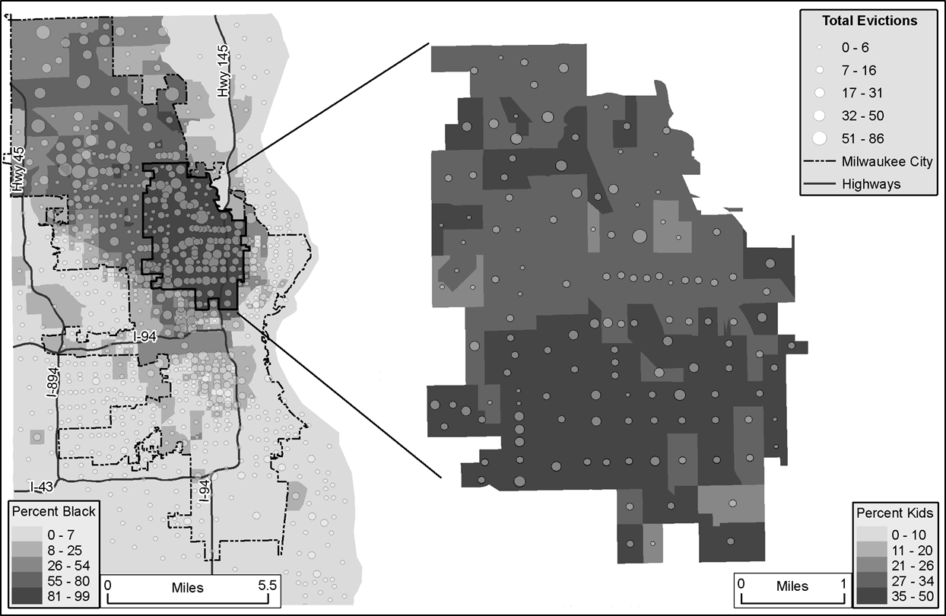
Eviction in Milwaukee

Slide 16
Mitch Dunier’s Sidewalk
http://wwnorton.com/college/soc/conley3/core/ch/02/socioClips.aspx

