Slide 1
“Nothing says family like a marriage license” -April DeBoer Marriage and Families of Different Kinds
Feb 27, 2014
Notes:
http://www.youtube.com/watch?v=BRDBvKGc1fE
http://www.youtube.com/watch?v=CPNK0VspQ0M
911 is a joke (song above)
Polygamy clip: http://www.thisamericanlife.org/radio-archives/episode/99/i-enjoy-being-a-girl-sort-of
Minnesota marriage agreement:
http://video.pbs.org/video/2290302882
Michigan marriage ban challenged videos:
http://www.youtube.com/watch?v=DN-ay1z-8Rc
http://www.wzzm13.com/story/news/politics/2014/02/25/hearing-begins-today-for-gay-marriage-decision-in-the-state-of-michigan/5801621/

Slide 2
Institution of Marriage
Tell me about the institution of marriage
Values, norms, beliefs, supporting organizations
Stand up if you want to get married someday (or already)
Deinstitutionalization of marriage/family (Cherlin)
What does this mean?
Social norms that define and guide marriage behavior weakening
Greater freedom (marriage and individualism conflict)
Romantic love or Confluent love (Giddens)
What does this mean?
Forever vs. stay in relationships that are rewarding
Notes:
Get into small groups and discuss first bullet. Have them write on board under headings: values, norms, beliefs, organizations

Slide 3
Selecting a mate
Do Sociologists Ask?
What are the five most important elements for a successful serious relationship?
What are you looking for in long term partner?
Compare & Discuss
80-90% in US marry people with similar religious values
Less than 15% marry different race/ethnic group
Most people choose a mate with similar age, place of residence, educational background, class, political philosophy, and moral values
Why?
What is the result?

Slide 4
Monogamy?
Do Sociologists Ask?
Or Serial monogamy?
40-45% of marriages end in divorce
Taking Sisterhood One Step Further
Is this feminism?
Notes:
http://www.thisamericanlife.org/radio-archives/episode/99/i-enjoy-being-a-girl-sort-of

Slide 5
Different kinds of “families”
Do Sociologists Ask?
Single parents
30% of HHs with children are single parent (2011, US Census Bureau)
Extended families vs. Nuclear families
What are some of the trade-offs?
Cohabitation
Same-sex couples
Takes a village

Slide 6
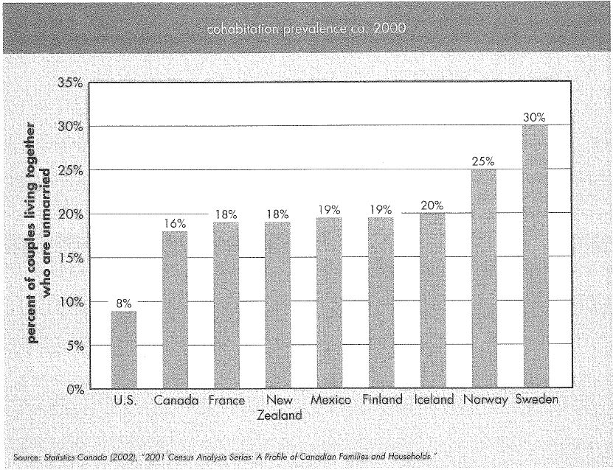
Cohabitation
Do Sociologists Ask?
How many of you have already or expect you might cohabit at some point?
Notes:
US % is still relatively small, but the number has more than doubled since 1990 and increased exponentially since 1970.
In 2009, 60-70% of the adult population between ages 19-44 had cohabited at some point. We just tend to eventually either marry or break up.

Slide 7
Divorce
Do Sociologists Ask?
Rates have declined somewhat since peak in early 1980s, but still 40-45%

Slide 8
Social Consequences of Divorce
Do Sociologists Ask?
Poverty among single female households
47% of parents owed child support in 2007 received full payment
25% received no payment
Long lasting affects on children
Educational attainment, health, relationships, divorce, income, occupational prestige

Slide 9
Sexuality
Do Sociologists Ask?
Homosexuality was defined as a mental disorder until 1973
Defense of Marriage Act (US 2004) grants married couples 1,138 rights not available to unmarried partners
The Michigan constitution bans same-sex marriage and places restrictions towards the forming of same-sex unions.
Notes:
In 2004, voters approved a constitutional amendment, Michigan State Proposal - 04-2, that banned same-sex marriage and civil unions in the state. It passed with 59% of the vote.
The Michigan Supreme Court later ruled that public employers in Michigan would not be legally allowed to grant domestic partnership benefits based on the recently passed measure.
The public opinion may have changed since 2004. A June 2009 poll showed a substantial shift in opinions towards the legal recognition of same-sex unions in Michigan, with 63.7% of residents supporting civil unions for same-sex couples and 46.5% of residents supporting full marriage rights for same-sex couples.

Slide 10
Same Sex Marriage
Do Sociologists Ask?
Human Rights campaign estimates 99% of all US counties have same-sex couples, and about 3.1 million people live in same-sex relationships.
http://video.pbs.org/video/2290302882
How do different social institutions affect same sex relationships?
Notes:
http://video.pbs.org/video/2290302882

Slide 11
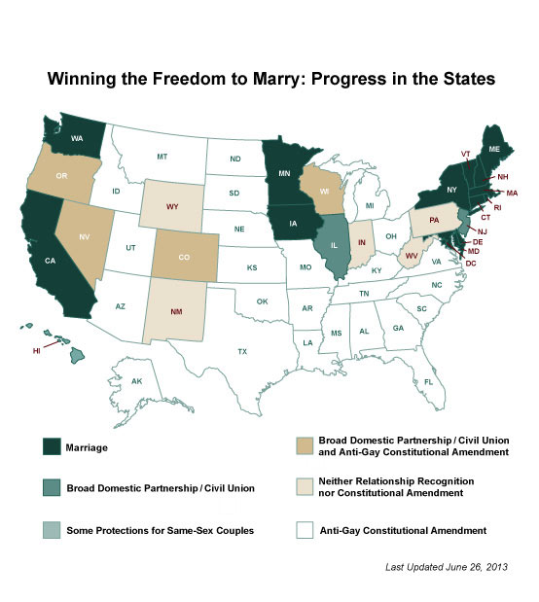
Change
Do Sociologists Ask?
Notes:
Outcome in MN
Three states—Rhode Island, Delaware and Minnesota—enacted laws that allow same-sex marriage in May 2013
June 2013 US Supreme Court recognizes legally married same sex couples
Thirteen states and the District of Columbia currently have laws that allow same-sex marriages. Another 35 states, including Michigan, have gay marriage bans through either laws or constitutional amendments.

Slide 12
Michigan’s Ban Challenged
March 2013
http://www.youtube.com/watch?v=DN-ay1z-8Rc
Feb 25, 2014
http://www.wzzm13.com/story/news/politics/2014/02/25/hearing-begins-today-for-gay-marriage-decision-in-the-state-of-michigan/5801621/

Slide 13
Changing Norms & Values around Marriage and Family
Do Sociologists Ask?
Marital decline position
Crisis of the family
Creates other social problems– poverty, delinquency, etc.
Marriage helps keep our societal house in order– teaches love & respect
So why not promote same-sex marriage?
Marital resilience perspective
Individual freedom of choice
Increased equality
More rewarding relationships
Less abuse
Notes:
Which are “legitimate”?

Slide 14
Questions
Do Sociologists Ask?
Choose 1 and Debate in small group:
Is same-sex marriage good or bad for society? Why?
Would making it harder to get a divorce create stronger and healthier families? If you were making divorce policy, what would you do? What are positive and negative aspects of your policy?

Slide 15
Book Clubs– Chapt 5
What do you think of Ms. Bailey?
What is the relationship between the gang and the community like
What does this chapter have to do with family?
Who “takes care” of this community? Why? How?
Formal institutions (like government, police, ambulance, etc.) are absent
Notes:
http://www.youtube.com/watch?v=CPNK0VspQ0M

