Slide 1
Inequality & Class
March 18, 2014
Notes:
Song– Merry Go Round-- https://www.youtube.com/watch?v=GZfj2Ir3GgQ
Intro: https://www.youtube.com/watch?v=YnQwTS-K6jI-- start at 1:25
Or maybe: https://www.youtube.com/watch?v=QPKKQnijnsM
We are starting a section on inequality. There are several types of inequality, this week we’re focusing primary on economic inequality. Next week, gender then race/ethnicity.
http://www.youtube.com/watch?v=IuqGrz-Y_Lc
http://scalar.usc.edu/works/growing-apart-a-political-history-of-american-inequality/index
http://www.nytimes.com/indexes/2005/06/05/national/class/index.html

Slide 2
Inequality
Societies are stratified into different groups
Power- direct others actions
Privilege- honor & respect
Prestige- income, wealth, land
who gets what, how they get it, and why
tied to race, gender, class, sexuality, religion, ethnicity, etc.

Slide 3
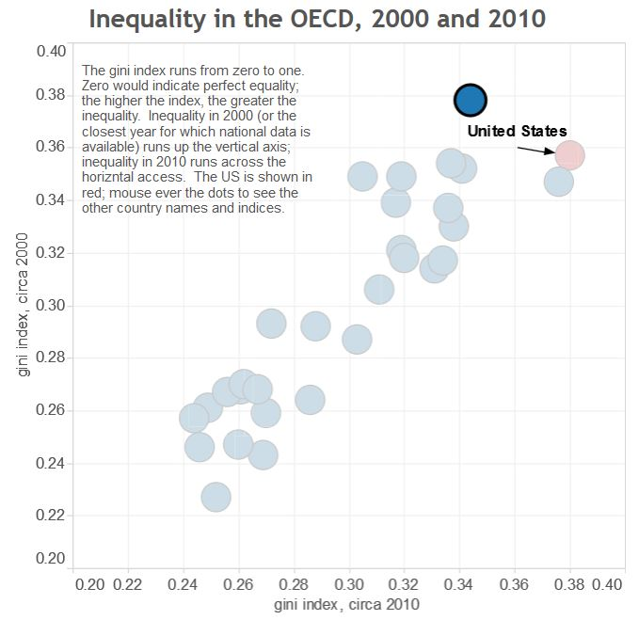
Economic Inequality in US
Notes:
Graphs from Colin Brooks- A Political History of American Inequality, http://scalar.usc.edu/works/growing-apart-a-political-history-of-american-inequality/index
US inequality within country was greater than any other OECD country in 2010. In 2000, Portugal was higher. In 2010, Isreal was almost as high.
See video at: https://www.youtube.com/watch?v=QPKKQnijnsM

Slide 4
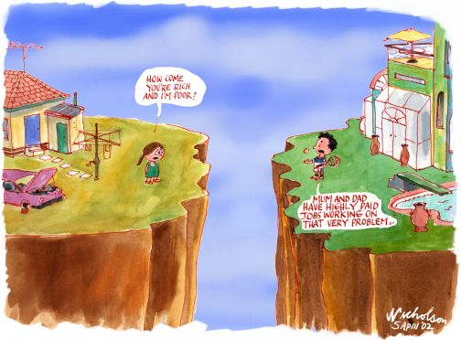
Why do we have such inequality?
Do Sociologists Ask?
Notes:
Functionalism
Conflict theory

Slide 5
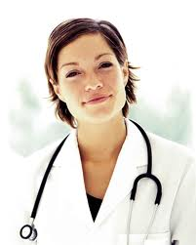
Critique?
Notes:
Functionalism says that inequality is always part of society and probably necessary and good overall.
Inequality is inevitable, desirable, and plays an important function
Important positions require more training and should receive more rewards
Encourages meritocracy based on ability
Doctor example:
Some positions in society are more highly valued because they are very important and require a lot of expertise.
Preparation involves talent, time, and money. We need motivation to get people to want to do these jobs– income, prestige, power
We need this unequal distribution of income/prestige/power to motivate folks to take on increased responsibilities, training, stress, etc.
Where does this fall apart? – rock stars vs. teachers, pro athletes vs. fire fighters, inherited wealth

Slide 6
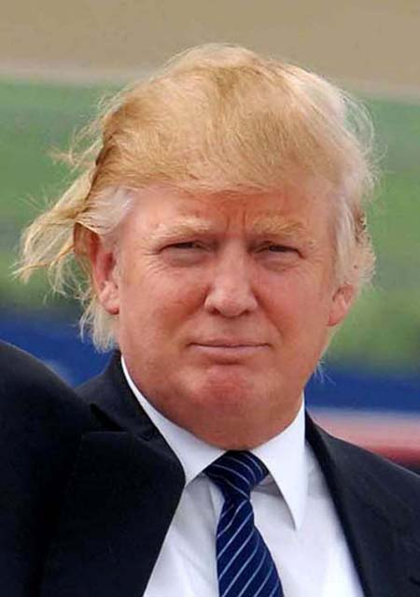
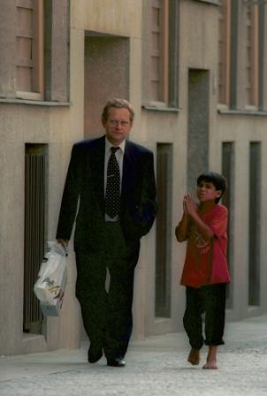
Critique?
Notes:
Conflict theory says that inequality is result of struggle over resources, where powerful take more than just what they need, but whatever they can. Powerful groups control institutions, organizations, norms, and values. World is divided into “haves” and “have nots” and there is little opportunity for advancing. Haves control the means of production and get to make the rules.
Inequality results from groups with power dominating less powerful groups
Inequality is bad because it hinders societal progress as those in power repress the powerless people in order to maintain the status quo
Positions are important so long as those in power consider them to be significant (the importance of positions is socially constructed)

Slide 7
Are rich people mean?
http://www.youtube.com/watch?v=IuqGrz-Y_Lc
What can we learn from this?
What does this suggest about how social forces shape our lives? About conflict theory?

Slide 8
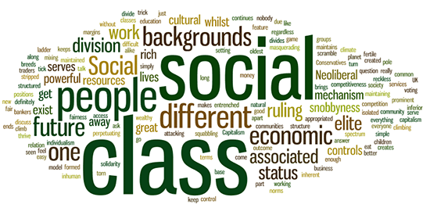
Social Class: What is it?
Notes:
Divide into small groups.
What is social class?
How do you know what class someone is in?
How does class matter or not?

Slide 9
Economic Classification
One’s location in production process
Karl Marx
Proletariat
Sell labor to produce things
Capitalist
Owns means of production. Exploits labor to make profit
Bourgeoisie
Manage, sell, teach

Slide 10
Culture is also important
Class is much more than a measure of how much money someone has in the bank account
Cultural capital
Skills, language, habits, preferences, types of knowledge, lifestyle, tastes
Send clues about our class and affect who we interact with, how comfortable we feel, and how we interact
Learned
Notes:
Lareau video

Slide 11
Class | Words | Words/Hour
Professional | 1,100 | 297
Working | 700 | 217
Low Income | 500 | 149
Notes:
Table shows number of words that children at 3 years old know and use by social class.
Language is an important part of culture and a way that inequality is reproduced through socialization, or symbolic interaction. Language is a set of symbols and a function of how we interact with one another. How might this difference in vocabulary difference affect one’s success in school? How might an expanded vocabulary affect one’s opportunities in life?

Slide 12
Continuum or Discrete Classes?
Discrete groups that share common social histories and predictable futures
Don’t mix much
Neighborhoods, schools, churches, work spaces, leisure activities

Slide 13
Class competition
Successes at upper end occur at expense of those on lower end
Profit max by min wages

Slide 14
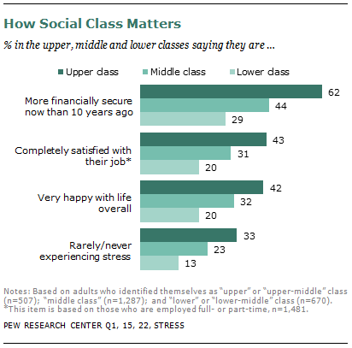
Class Matters

Slide 15
Your Class
What is your social class?
How do you know?
Tell a story about when and how your class position became apparent
How has your class affected your life chances to date? How do you see it affecting your life in the future?

Slide 16
Family & Class
What does Callero argue?
How is family related to class?
Is the American Dream for real? How so and how not?
Notes:
Annette Lareau clip

Slide 17
For Thursday
Canvas Quiz Due
Debates:
Raising minimum wage
Greater taxes on top 1%

Slide 18
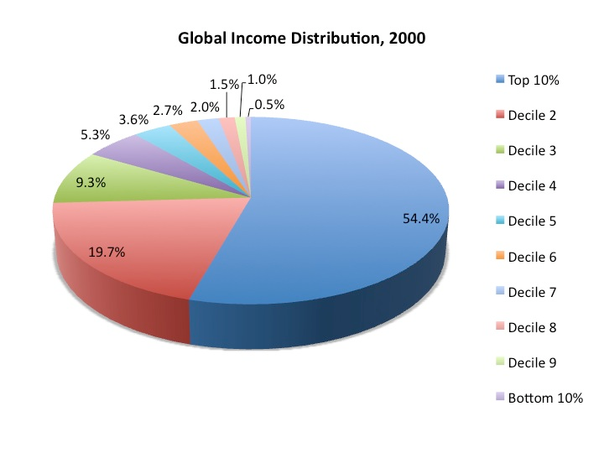
Notes:
References:
Dikhanov, Yuri. 2005. Trends in Global Income Distribution, 1970-2000, and Scenarios for 2015. Human Development Report Office (HDRO), United Nations Development Programme (UNDP).

Slide 19
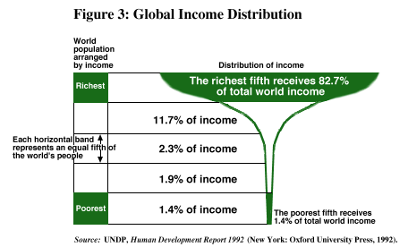
Notes:
Go to gapminder.
About 9 million children under 5 die each year, and mostly from preventable causes – lack of adquate food, clearn water , routine immunization

