Slide 1
Social Change
April 15, 2014
Notes:
Intro Song: https://www.youtube.com/watch?v=LgLD4FXesew
http://www.ted.com/talks/hans_rosling_on_global_population_growth?language=en

Slide 2
Social Issue blog
Choose a specific issue of public importance- explain why
Describe the issue using data/evidence (1-2 sources)
  Census, Kids Count (exercise 2)
  Govt documents, reports, policies
  Press, pictures, clear examples
Analyze issue using sociological imagination
  Explain how the issue comes to be or gets perpetuated
  Concepts and theories from class
  Sociological studies (peer reviewed)- 2 to 3 sources
Interpret findings
Suggest alternatives

Slide 3
Social Issue Blog- writing
Write as a professional, not a student
Public is audience, not instructor
Be concise and to the point
Use clear language and strong statements backed up with evidence/data

Slide 4
The only thing consistent is change.
Notes:
Processes of change are inevitable features of groups and societies. To survive, groups and societies must evolve and change in response to changes in the broader social and physical environment.
When we talk about social change, we mean variation over time in the structure (institutions), culture (norms and values), and behavior patterns in society.

Slide 5
Powerful social structures constrain what we do, but they can never control entirely.
Human beings are not passive actors. Individuals acting alone, or with others, can shape, resist, challenge, and sometimes change the social structures that impinge on them.
These actions constitute human agency.
Notes:
We’ve learned about a lot of problems and issues in society this semester. And we’ve learned about the ways in which our choices as individuals are limited and shaped by larger social structures. This can be depressing, but the good news is that YOU CAN MAKE A DIFFERENCE!

Slide 6
Reification
Georg Lukacs
when people give social institutions like the economy, social organizations such as the government, or even society in general deity-like powers over their life, life course, and fate
We still have agency
First step toward change is being conscious of the social forces at work

Slide 7
Durkheim—
“Sociology is not worth a single hour’s work if it does not help change the world for the better.”
Notes:
As we start to wrap up this semester, I hope that you have learned some things in this course that will help you contribute to the dialogue about how to make our social world a better place.

Slide 8
Do we want change?
Change is hard
Change means progress
Good vs. Bad?
Complex
  Winners and losers

Slide 9
Models of Social Change
Evolutionary/functionalism
  Change maintains social stability as society adapts to changing conditions eliminating dysfunction and adapting to new conditions
  Dominant culture assimilates
Critiques
  No actors
  Assumes change is necessarily good
  Little room for social transformation (big change)

Slide 10
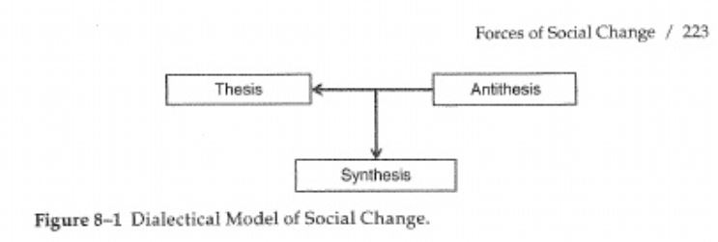
Models of Social Change
Dialectical
  Existing structures are challenges by oppositional force
  Outcome is usually a compromise between the two
  Dominant culture changes
  Emphasizes process & actors are key

Slide 11
Resisting Change
Do Sociologists Ask?
Protect the status quo
Potential disruption to larger functioning of society
  Institutions don’t like change
Counter-movements
Social pressure against working for change
Unintended consequences

Slide 12
Your Adventure in Social Change: Activity Posting 6
Do Sociologists Ask?
Movement to break down “us” vs “them” thinking
Positive interactions is key
Tell about your experience
What did you learn about the unfamiliar group?
What did you learn about yourself?
Do you think this experience had any impact of breaking down “us” vs “they” thinking inside of you? Of the group members you interacted with?

Slide 13
What Spurs Social Change?
Do Sociologists Ask?
Population dynamics
Cohort Effects and Replacement
Environment
Major events/crises
  Wars/acts of terrorism
  Economic crisis
  Natural disasters
Science & Technology- Experts, Corporations
Leaders
  Top Down: through policy– State, Corporations
  Bottom Up: collective action/social movements

Slide 14
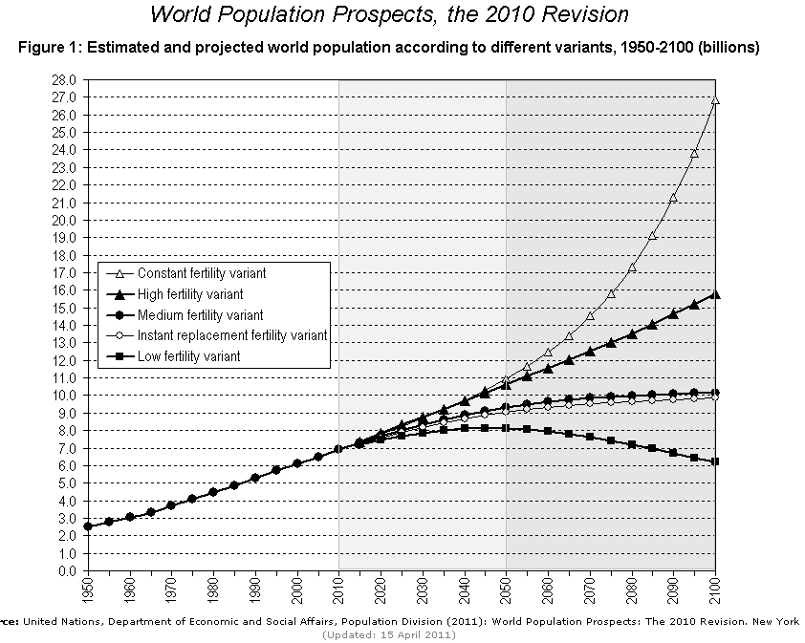
Notes:
Population growth projections

Slide 15

Can the planet support it?
Do Sociologists Ask?
Finite planet with some limits to growth
More people could mean more resource use, pollution, etc.
Higher consumption also degrade env
Human ingenuity pushes limits
Notes:
Role of population growth, consumption in global north, emerging economies in contributing to climate change.
1- This is a really complicated problem.
2- I didn’t set this up for there to be any “right” answer. What do you all think is the right answer? Why?
3- There is solid evidence that each of these is an important contributor.
4- In reality most sociologists would agree that all are important, but some argue that population growth is NOT important– blame the victim.
Hans Rosling: http://www.ted.com/talks/hans_rosling_on_global_population_growth?language=en

Slide 16


Slide 17





Cohort effects drive lasting social change
Notes:
A good example of something with a strong cohort effect is smoking: likelihood of adoption is strongly related to age (teenage/young adult) and the current social culture, and its addictive so that continuing to smoke throughout life, largely depends on starting to smoke as a teenager/young adult. Hunting is similar. First hunting experiences typically happen at young ages and depend of the social and environmental circumstances, and many say it is addictive so that people who hunt continue to hunt throughout their life.
With both smoking and hunting, the number of people who smoke/hunt at some point in the future is largely dependent on the number of people who started at younger ages, minus those who’ve quit, minus those who’ve died. There are relatively few new adopters at older ages. So, the number of people in a cohort, together with the culture the cohort develops, has a large impact on the number of hunters.

Slide 18
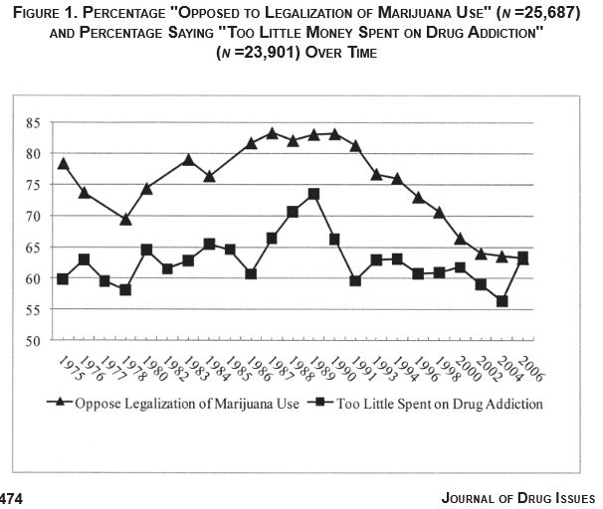
Nielsen, Amie L. 2010. “Americans’ Attitudes Toward Drug-Related Issues from 1975–2006: The Roles of Period and Cohort Effects.” Journal of Drug Issues 40(2):461–93.
Notes:
Percentage opposed to legalization of marijuana has declined dramatically since about 1990.
How can we explain this pattern?
Research suggests it is a combination of period and cohort effects. Attitudes about homosexuality and acceptance of same sex marriage are similar, in that research suggests both period and cohort play a large role.

Slide 19
Age- Period- Cohort Effects
Age: biology, lifecourse, social situation
Period: current events, environment
Cohort: events affect people at different ages differently

Slide 20
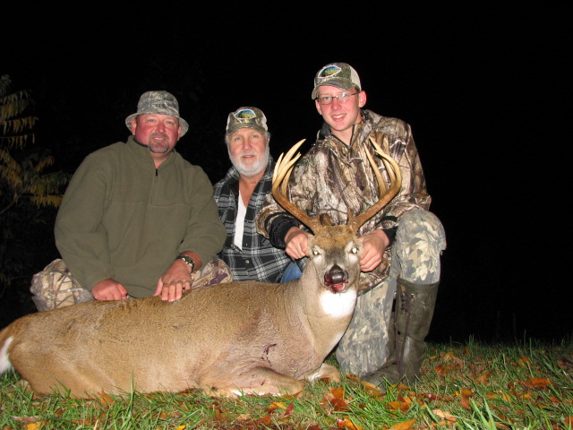
Deer Hunter Demography
An Age-Period-Cohort Approach
Richelle Winkler
Assistant Professor of Sociology and Demography
Dept of Social Sciences/Environmtnal & Energy Policy Grad Program
Michigan Tech University
rwinkler@mtu.edu
Notes:
Thank you for inviting me to be here today.
I’m very interested in getting to know some of you and to learn more about wildlife conservation and management in Michigan. And, this invitation gave me a good excuse to drive across the bridge and visit the Lower Peninsula.
My purpose today is to provide an overview of some of the major demographic trends affecting Michigan and relate these patterns to implications for wildlife conservation and management.
Note: 40 minutes

Slide 21
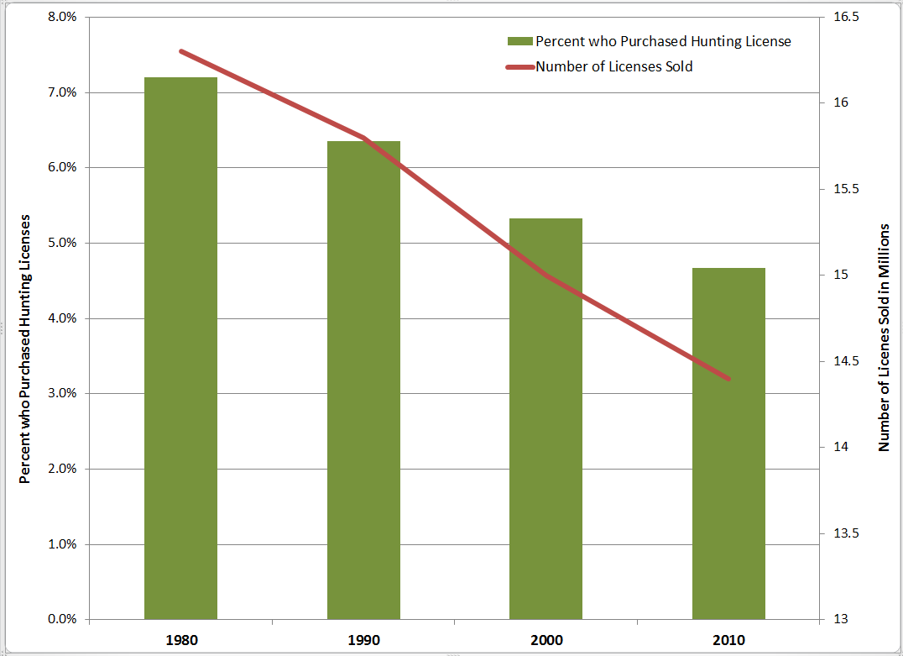
Sources: US Fish and Wildlife Service Hunting License Reports, US Census Bureau
Notes:
Across the United States the number of hunting licenses sold and the proportion of the population who hunts has been declining for the last several years. Angler data looks similar.

Slide 22
Baby Boom
Baby Bust
Boomlet
Notes:
In Michigan, the number of deer hunters increased dramatically between 1960 and 1980. It then leveled off until about 2000, but has declined considerably over the last decade.
How could the number of deer hunters in Michigan almost double in a twenty year period? And so sure, we’ve seen a little decline in the last few years, but couldn’t the number of hunters just turn around and increase again, like before?
Well… the Baby Boom happened. And….Its sure NOT going to happen again.
Thanks to Brian Frawley for providing these estimates.
Sources: “A History of Deer Hunting in Michigan” (http://ww2.dnr.state.mi.us/publications/pdfs/HuntingWildlifeHabitat/Reports/WLD-library/2800-2899/2868.pdf).

Slide 23
Notes:
Wisconsin follows an incredibly similar pattern. I wanted to show this, because I’m going to be using a lot of data from Wisconsin today and I think this chart shows that the comparison is relevant.

Slide 24
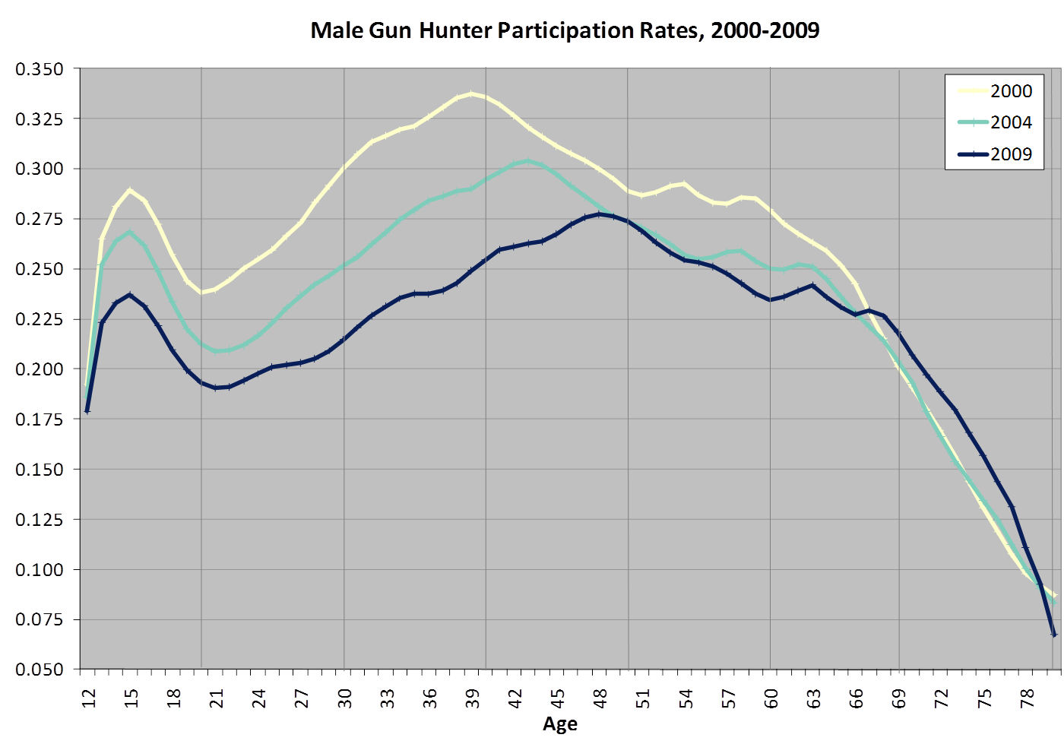
Notes:
This chart shows the proportion of Wisconsin males who purchased gun deer hunting licenses in 2000, 2004, and 2009 by age. I want to use this chart to talk about age, period, and cohort and how they are related.
Age. As you might imagine, participation in hunting (or any kind of outdoor recreation and many other activities) is related to age. Age affects our physical capabilities, and it is also related to important life course events (going away to college, having children, and retiring). You can see in the chart that hunter participation is highest among teens, age 14-17, then drops off markedly in the late teens/early twenties, before increasing again, and eventually there is a large drop off in participation at older ages, after about age 65. This pattern suggests that age matters.
Period. When I say period, I’m referring to social and environmental conditions at a given period of time. Period effects influence people at all ages. This might include the economic recession, a bad winter, a large number of big bucks in the herd one year, the discovery of Chronic Wasting Disease, etc. This chart shows evidence of period effects influencing hunter decline as participation rates decline each year for people at almost all ages, the exception being those over age 65.
Cohort. Again, cohort effects are essentially the idea that period effects influence people at different ages to a greater or lesser extent. So, going hunting as a teen on a frigid day when you see no deer may have a different effect on likelihood to hunt in the future than it would on a seasoned forty year old hunter whose seen more better hunting days and, despite the cold, is escaping a houseful of hectic kids, housework, and maybe a domestic relationship that’s gone sour.
The chart shows evidence of cohort effects in that the peak of hunter participation in 2000 was at age 39, four years later in 2004 the peak is now four years older, and nine years late in 2009, the peak is now at age 48. The peak drops each year as some people quit hunting, but it continuously shifts forward in time and age. The pattern suggests that the cohort of Wisconsin males born in the late 1950s and early 1960s (Baby Boomers) are more likely to hunt than cohorts born at other ages.
Overall, this simple chart suggests that age, period, and cohort effects all play a role in determining the ultimate number of Wisconsin deer hunters.

Slide 25
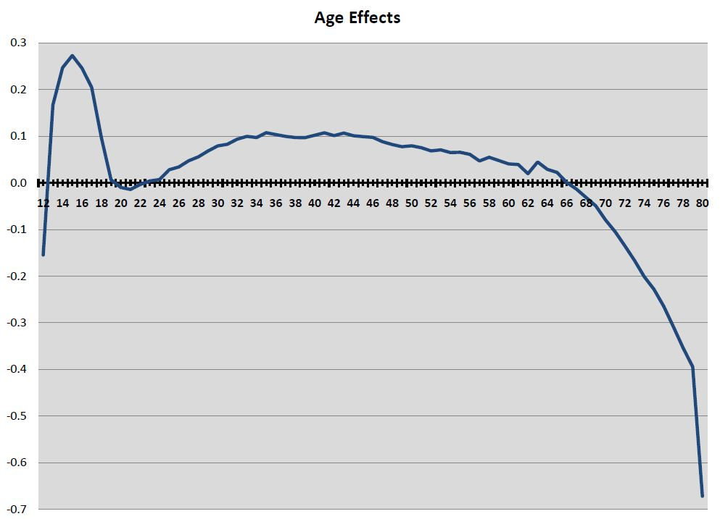
Notes:
So, when I first started investigating Wisconsin hunter decline and I looked at the previous chart, I knew that it would be critical to understand the independent contribution of age, period, and cohort effects in order to provide some sense of what is contributing to hunter decline and to generate accurate projections of the future number of Wisconsin hunters.
Using a technique called age-period-cohort analysis, I estimated the independent effects of age, period, and cohort on Wisconsin male gun hunter population change 2000-2009. Now, I have to mention that this is only 10 years worth of data, and ideally there would be a much longer time period so that more the full lifecourse of specific generations could be analyzed. But, the results here are still revealing, and they match up well with survey data that provides a longer history.
The chart shows that controlling for period and cohort, age plays an important role in hunter participation. Most importantly, rates are high among teens as they are introduced to hunting, and they drop off considerably after age 65 and especially after age 70.
Notes: These charts (this one and the two that follow) can be read like likelihood ratios with the likelihood of hunting increasing moving up the vertical access and decreasing moving down. Negative values indicate that at those ages, age contributes to a decrease in hunter participation.

Slide 26
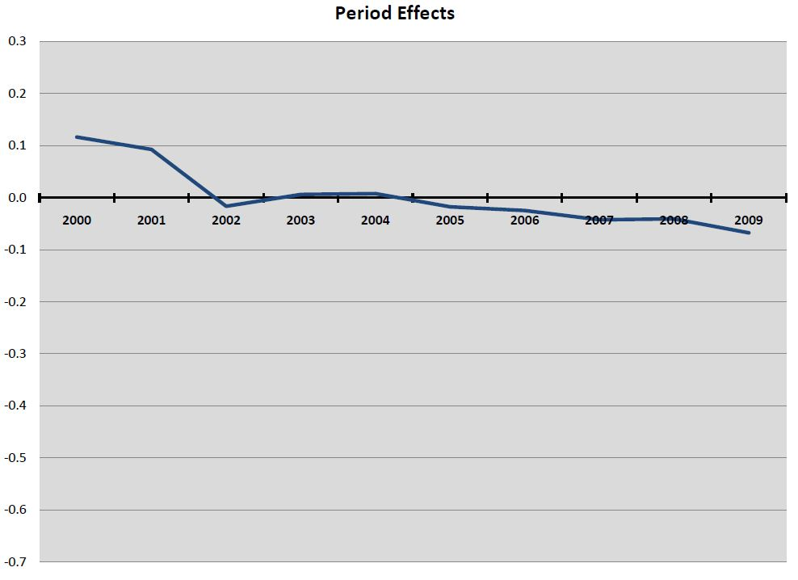
Notes:
Period effects.
Period effects have not been as strong as age or cohort effects, but you can see a steady decline in participation rates over time. There was a clear drop in participation in 2002 when Chronic Wasting Disease was discovered in the Wisconsin herd, a slight rebound in the years following, and then continued decline.

Slide 27
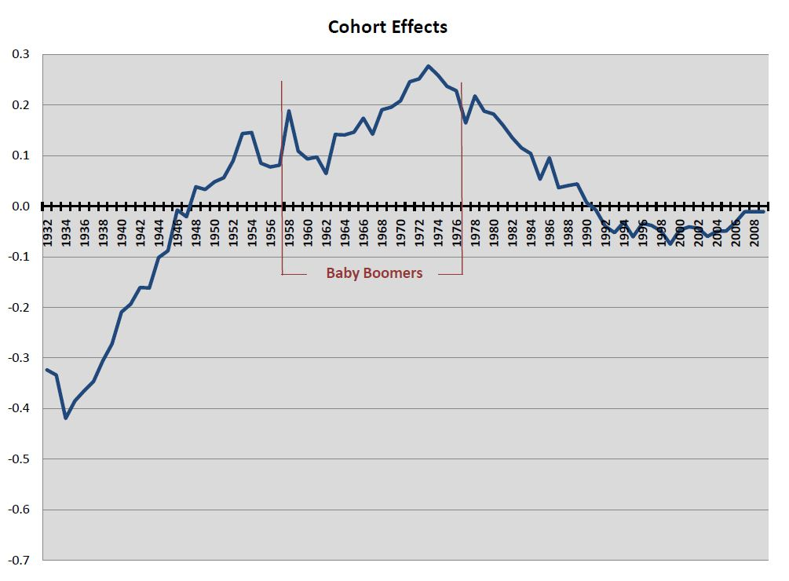
Notes:
Cohort effects.
Like age, cohort effects play a vital role in hunter participation. In particular those born near the end of the Baby Boom generation (1955-1965) have been particularly likely to hunt. Cohorts born since 1979 (starting hunting in 1992 and later) have had a decreased likelihood of hunting.
Note: Cohorts are defined in this chart according to the year they became eligible to gun deer hunt in Wisconsin (age 14), rather than by year of birth. Also note that because a limited set of data are available (2000-2009), I don’t much trust these estimates for the older cohorts. Here the strong negative effects of old age and likely getting confounded with cohort effects.

Slide 28
Notes:
And, what can we do with this information?
We can use it to inform population projections and planning for future wildlife conservation and management.
This chart shows population projections of the future number of Wisconsin male gun deer hunters out to 2030. There are 3 models shown. The dotted one at top simply assumes that age-specific participation rates observed in 2009 will remain constant every year into the future. I don’t believe this model to be very realistic, because all of the data indicate that these participation rates have been steadily declining. Nonetheless, this model represents what might be considered a “best”-case scenario (a sudden stop in the decline of participation rates). The other two lines represent what I believe to be more realistic projections, and which have, in fact, proven to be very much on target in 2010-2012 seasons.
The APC model is directly informed by the APC analysis I just showed. It assumes that participation rates are affected by age, period, and cohort over time. Results of this model were remarkably similar to the a more traditional demographic projection technique called the cohort survival projection. Both indicate that the observed recent decline in the number of Wisconsin deer hunters is only the beginning of a much more pervasive pattern.

Slide 29
Leadership & Planned Change
Do Sociologists Ask?
Planning
  Strategic planning in organizations
  Urban and regional planning
  Including participants (workers, community, etc.) in planning is key to buy-in
Social movements
  Organized attempts outside of established institutions to enhance or resist change through group action

Slide 30
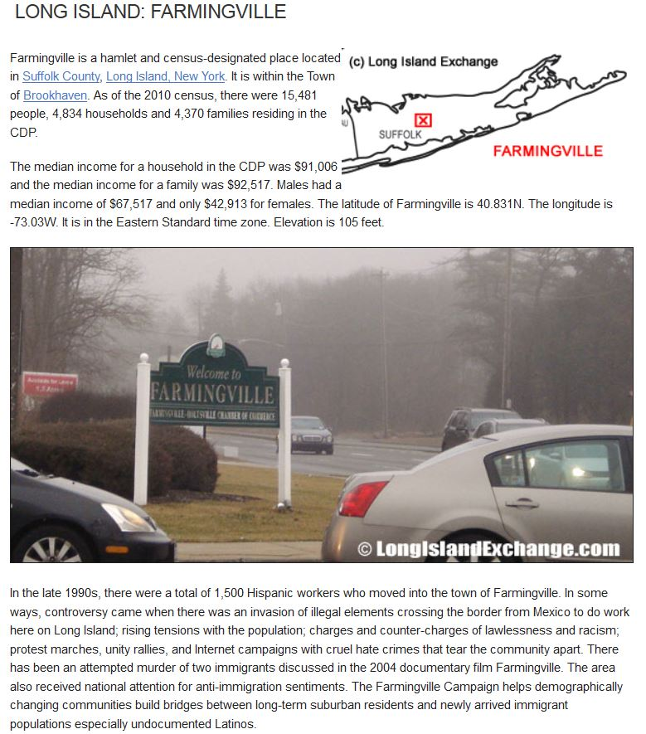
Change & Movements:
Farmingville
Example

